Slide 1
Future of Food Packaging | More Sustainable Food Packaging
May 2023

Slide 2
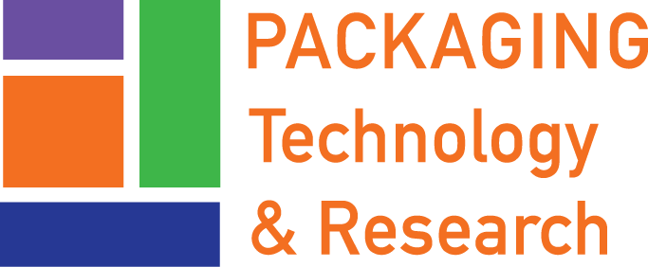
ABOUT PTR Dr. Claire Sand thinks “all food packaging all the time”
Claire’s mission is to enable a more sustainable food system with science and value chain innovations that more sustainably increases food shelf life and prevents food waste
35+ years of food packaging experience
Ranks innovative packaging science and value chain solutions to extend shelf life
Generates implementation roadmaps and aligns business cases
IFT Fellow, Riester-Davis-Brody life-time achievement in food packaging award recipient
Doctorate in Food Science and Nutrition at University of Minnesota
MS and BS in Packaging at Michigan State University
Owner
Adjunct
Professor
Monthly
Columnist
Current Leadership & Editorial Boards
Recent
Awards
CoChair
Consortium on
Food Waste
Advisor
Food Waste Repackaged
Executive Board
Riester-Davis-Brody
Food Packaging
Lifetime Achievement Award
Editorial Board
Associate Editor
Reviewer
National Science Foundation
Editorial Board
IFT Fellow

Slide 3
PTR’s WORLD Packaging Science and Value Chain Expertise
Technology
Business Case Building
Topics include:
Future of
Food Packaging
Active
Packaging
Intelligent Packaging
Value Chain Drivers
Process & Package Interactions
Migration Complexities
Global Research Institutes
Material Science
Consumer Research on Sustainability
More Sustainable Packaging
Our solutions are tailored to client needs
Food Waste
612.807.5341 / claire@packagingtechnologyandresearch.com / PackagingTechnologyAndResearch.com

Slide 4
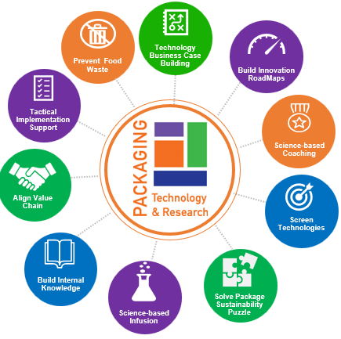
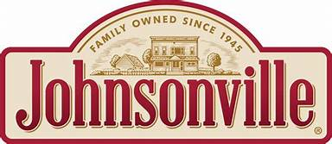
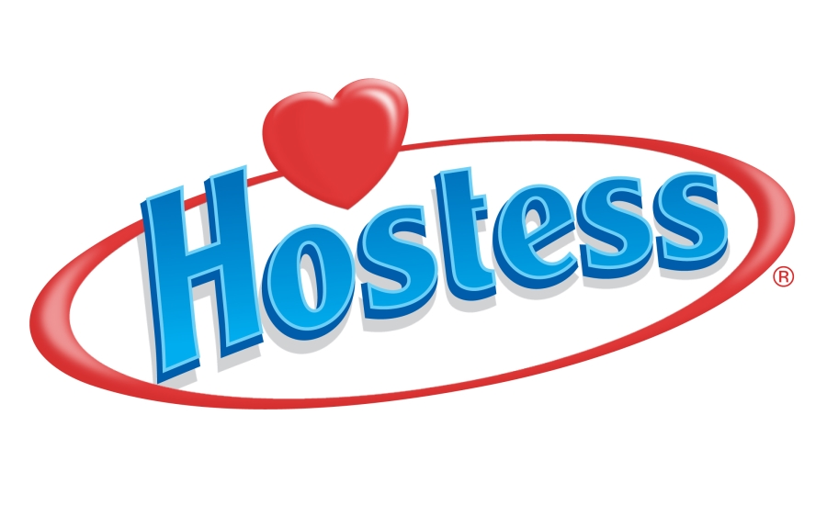
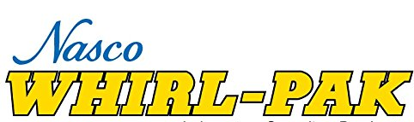
ABOUT PTR Selected Clients
Food Industry Packaging Industry Associations

Slide 5
ABOUT PTR Our Services – 4 areas
More Sustainable Packaging
Food Waste Reduction
Problem Solving & Technical Consulting
Strategy & Roadmaps
We unlock the optimal blend of food and packaging science, value chain experience, and consumer insights to achieve more sustainable packaging for our clients.
CLIENTS: PACKAGING AND FOOD COMPANIES AND ASSOCIATIONS
We empower our clients with packaging solutions to prevent food waste, meet bold commitments on addressing UNSDGs, food justice, hunger, and GHG. reduction
CLIENTS: PACKAGING AND FOOD COMPANIES AND ASSOCIATIONS
We help uncover and shine a spotlight on what’s working and what is NOT to help our clients take bold steps rooted in science-based packaging expertise.
CLIENTS: PACKAGING AND FOOD COMPANIES & LEGAL FIRMS
We steer our clients’ futures by developing science-based, systems-thinking strategies and roadmaps to ensure both an intelligent plan and a strong business case.
CLIENTS: PACKAGING AND FOOD COMPANIES AND ASSOCIATIONS

Slide 6
More Sustainable Packaging Take-Aways
Packaging’s role in moving the dial on a more sustainable food system is more appropriately focused on preventing food waste
More Sustainable Packaging
Where we are now demands focus on moving the dial
>Sourcing - Biomass-derived PE and PET are drop-in solutions
> Disposal - Value chain, design and systems thinking is needed
Fundamental shifts have promise

Slide 7
How it happens Achieving a More Sustainable Food System
Less
Food Waste
More Sustainable
Packaging
More Sustainable
Food System
Conducted value chain analysis that identified 287 product, process, and package solutions with 1.1 billion pounds in reduced food waste for 6 Minnesota crops - AURI
Sourced, screened, and ranked intelligent packaging options to reduce food waste by 10% and 15% and improve food safety and reduce labor associated with the product use for a QSR suppliers
Defined QSR value chain drivers to build the business case for packaging that decreases food waste
Ranked packaging solutions to reduce food waste by category impact and feasibility to channel research and development for multi-industry stakeholder groups for food and packaging companies - ReFED
------------------------------------------------------------- Guided Package Material Switching
Discerned 5 different package sourcing implications by varying scopes on LCAs in the fresh produce industry
Pinpointed package material sustainability differences using Forensic LCA and analysis
Identified, sourced, and developed 50+ more sustainable material options for 3 structures with the same product shelf life and operational performance solutions that provided a 10-46% reduction in climate change
Identified, sourced, and developed 156 solutions that provided a 10-212% reduction in climate change
Package design for 15+ entrepreneurs seeking to connect brand and product characteristics to more sustainable packaging
Employed advanced material science to construct 4 more sustainable packaging systems
Achieved 5 more sustainable packaging designs by linking value chain needs with internal constraints
Redesigned packaging systems to meet QSR needs and lower the total environmental footprint
Conducted directional Consumer Research to guide decision making on 6 more sustainable packaging options in the meat industry
Employed UNSDG Target 12 to link more sustainable packaging and food waste for 3 major brands
Defined sustainability strategy for a company with 12 packaged food brands
Built the Business Case for more sustainable packaging using value chain drivers of retailer, consumers, and post-consumer handlers for 15+ products
-------------------------------------------------------------- Refined Package Design

Slide 8
How it happens More Sustainable Packaging
Rationale
Actually be more sustainable and not reduce product shelf life
Defensible
Be communicated to retailer, consumers, and post-consumer handlers
in a meaningful manner
Achievable
Uses what is viable in 1,3,5 years within defined constraints
Linked
Aligns with retailer, consumers, and post-consumer handler needs and targets
612.807.5341 / claire@packagingtechnologyandresearch.com / PackagingTechnologyAndResearch.com

Slide 9
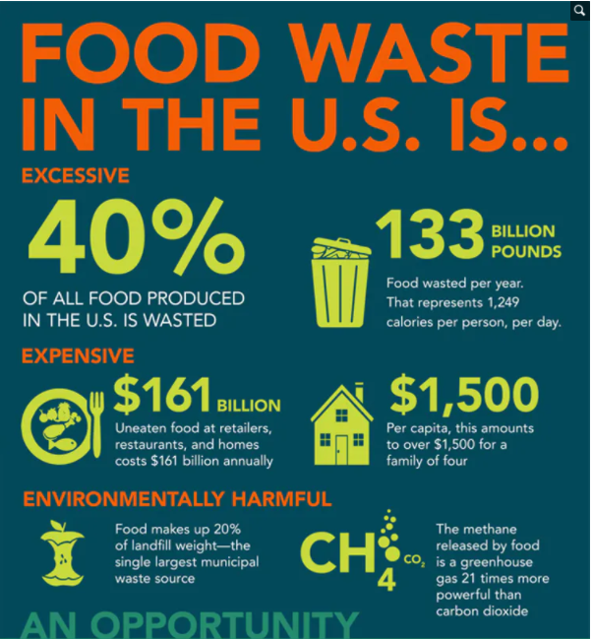
How it happens More Sustainable Packaging Prevents Food Waste
If food waste was a country, it would rank 3rd in CO_{2eq} behind China and the United States
Science-based and value-chain based packaging solutions to prevent food waste are abundant
Different foods demand different packaging requirements
A pragmatic- and science-based approach ranks packaging solutions by their ability to halt major degradative reactions
More sustainable packaging does not increase and instead prevents food waste

Slide 10
How it happens A comparative impact of packaging is essential
A complete picture of the impact that packaged food has on the environment is needed for perspective
Poore and Nemecek, 2018

Slide 11
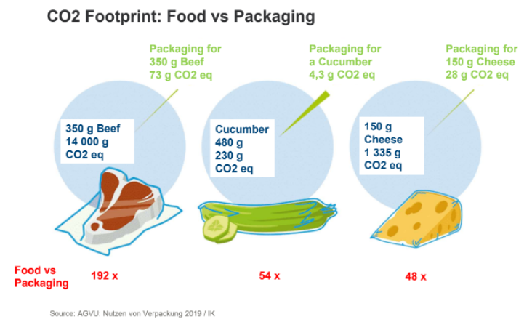
How it happens A comparative impact of packaging is essential
CO2 Footprint: Food
vs
Packaging

Slide 12
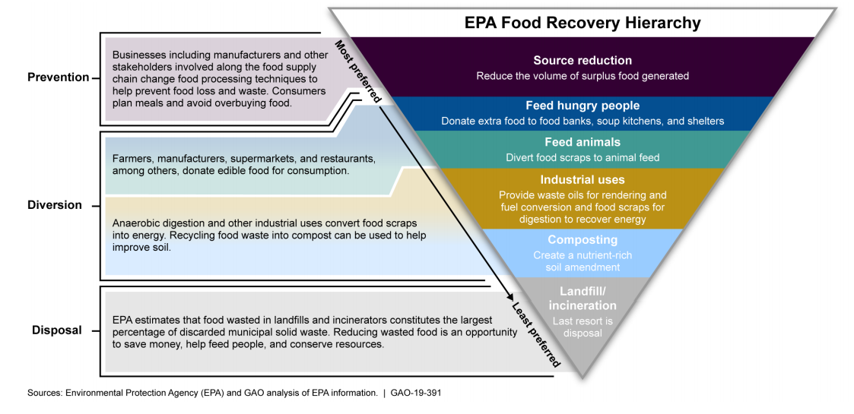
How it happens Solutions to FLW vary in impact
PREVENTION - SOURCE REDUCTION
Analysis identified viable projects including: AURI coproducts for human consumption and AURI focus on farms and processors
DIVERSION - FEED ANIMALS
AURI coproducts for animal consumption; PTR analysis identified viable projects in this arena
DIVERSION INDUSTRIAL USES
AURI bio-derived energy; PTR analysis identified WTE viable projects
(EPA.gov)
Notes:
EPA Food Recovery Hierarchy demonstrates that the most environmental impact from reducing food waste can be achieved by “Source Reduction”, meaning preventing food waste

Slide 13
How it happens Oxidation Assessment

Slide 14
How it happens Moisture Gain/Loss Assessment

Slide 15
How it happens Microbial Assessment

Slide 16
MORE Sustainable Packaging Prevents Food Waste

Slide 17
How it happens Least Food Waste with the Most Sustainable Packaging
More Sustainable Packaged Food
More Sustainable Packaging
Less Food Waste
Sustainability means less food waste and more sustainable packaging
Labeling to increase sorting and collection
Light Responsive O₂ Scavenging
Paperboard COC
Systems Solutions
In-store MAP
Sustainably sourced
bioderived recyclable polymers
Integrated IoT/IoP with CWI & packaging disposal directions
TTIs
Compostable polymers in focused venues
O₂ absorbing films
and sachets,
CO₂ emitters
and MAP
Separable packaging
Edible antimicrobials
CWI via TTI
Improved systems for collection, sorting, processing of recyclables and compostables
Polymer science: Responsive packaging
Returnable climate controlled shipping
Polymer science: More Recyclable Packaging
Flex-Pack

Slide 18
More Sustainable Packaging Take-Aways
Packaging’s role in moving the dial on a more sustainable food system is more appropriately focused on preventing food waste
More Sustainable Packaging
Where we are now demands focus on moving the dial
>Sourcing - Biomass-derived PE and PET are drop-in solutions
> Disposal - Value chain, design and systems thinking is needed
Fundamental shifts have promise

Slide 19
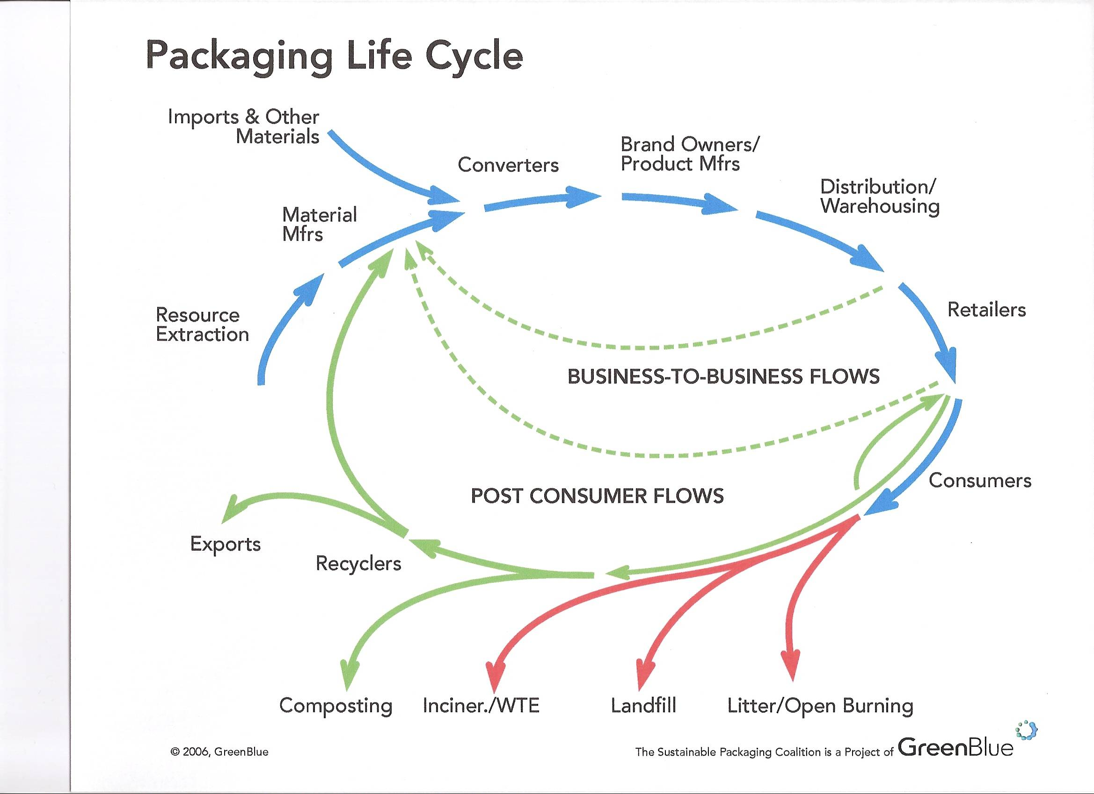
Packaging Life Cycle

Slide 20
The Waves of Sustainability
2nd Wave
1969 and the Cuyahoga River was burning
3rd Wave
Global supply
Triple Bottom Line - TBL
People, Profit, Planet - PPP
Corporate Social Responsibility - CSR
4th Wave
4th Wave – Sustainability Age of Reason
Motivated by negatives
Silent Spring
Weather inversions in London and NYC
Earth Day and EPA 1970
Ended in USA in 1990s
Greenwashing
Eroded consumer trust
Motivated by positives
Food waste awareness
Global brands & packaging suppliers

Slide 21
WHERE WE ARE NOW l More Sustainable Packaging Prevents Food Waste
WHERE WE ARE NOW
More Sustainable Packaging Prevents Food Waste

Slide 22
WHERE WE ARE NOW Tailwinds
Focus on the End Game
More sustainable food system is advancing
UNSDGs link food waste and packaging
Business case can align
Packaging has power
5th Industrial Revolution linking information with emotions
Unique position/power of Retailers
Shared Value
Design innovation
Material science delivers
100% Bioderived PET advance
Compostable un-reality is eminent
Chemical and mechanical recycling finesse

Slide 23
WHERE WE ARE NOW Headwinds
Packaging Industry not leading in a concerted manner
- Reactionary Industry Leadership remains after trust has eroded
“we have been here before” feeling from established leaders
Social pressure not Science dominate discussion
- Consumer opinions are no fact based
Legislation lack scientific understanding
Brands are being bullied into bad decisions
Lack of Responsibility
- Lack of focus on common need for collection and sorting
Brands and packaging industry continue to erode trust
Investment disconnected to End Game

Slide 24
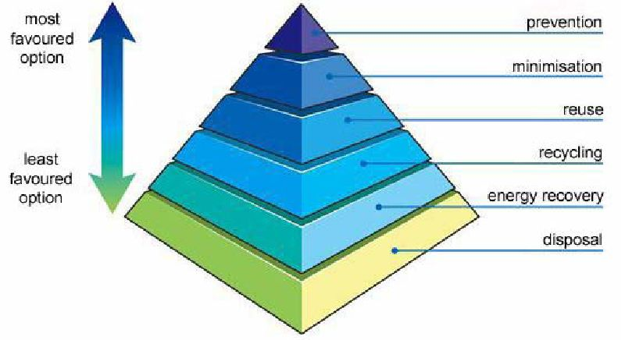
WHERE WE ARE NOW Options

Slide 25
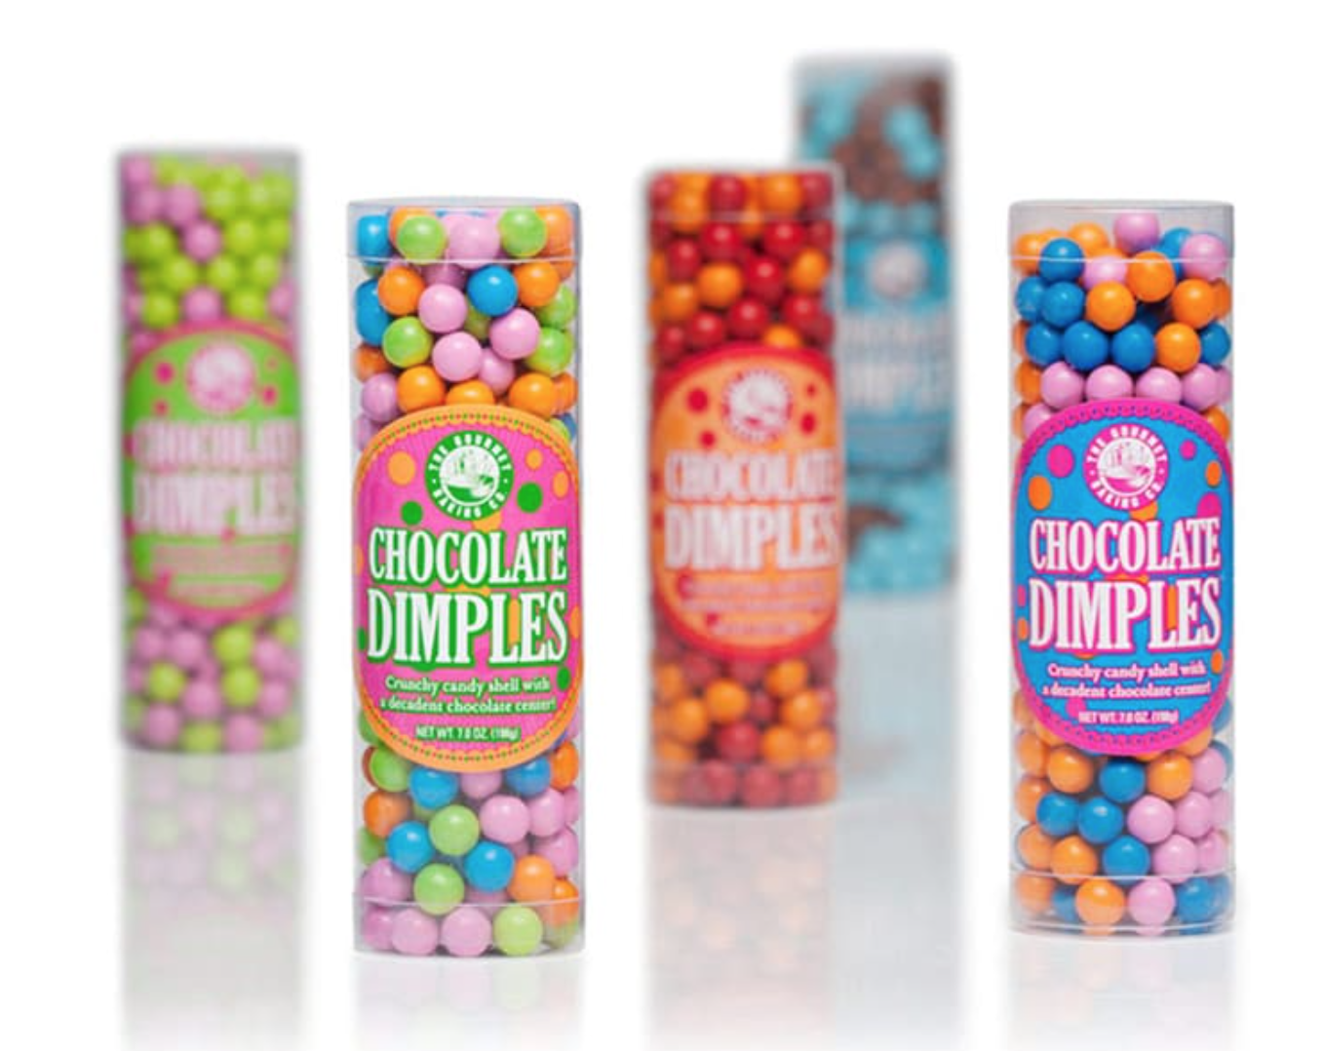
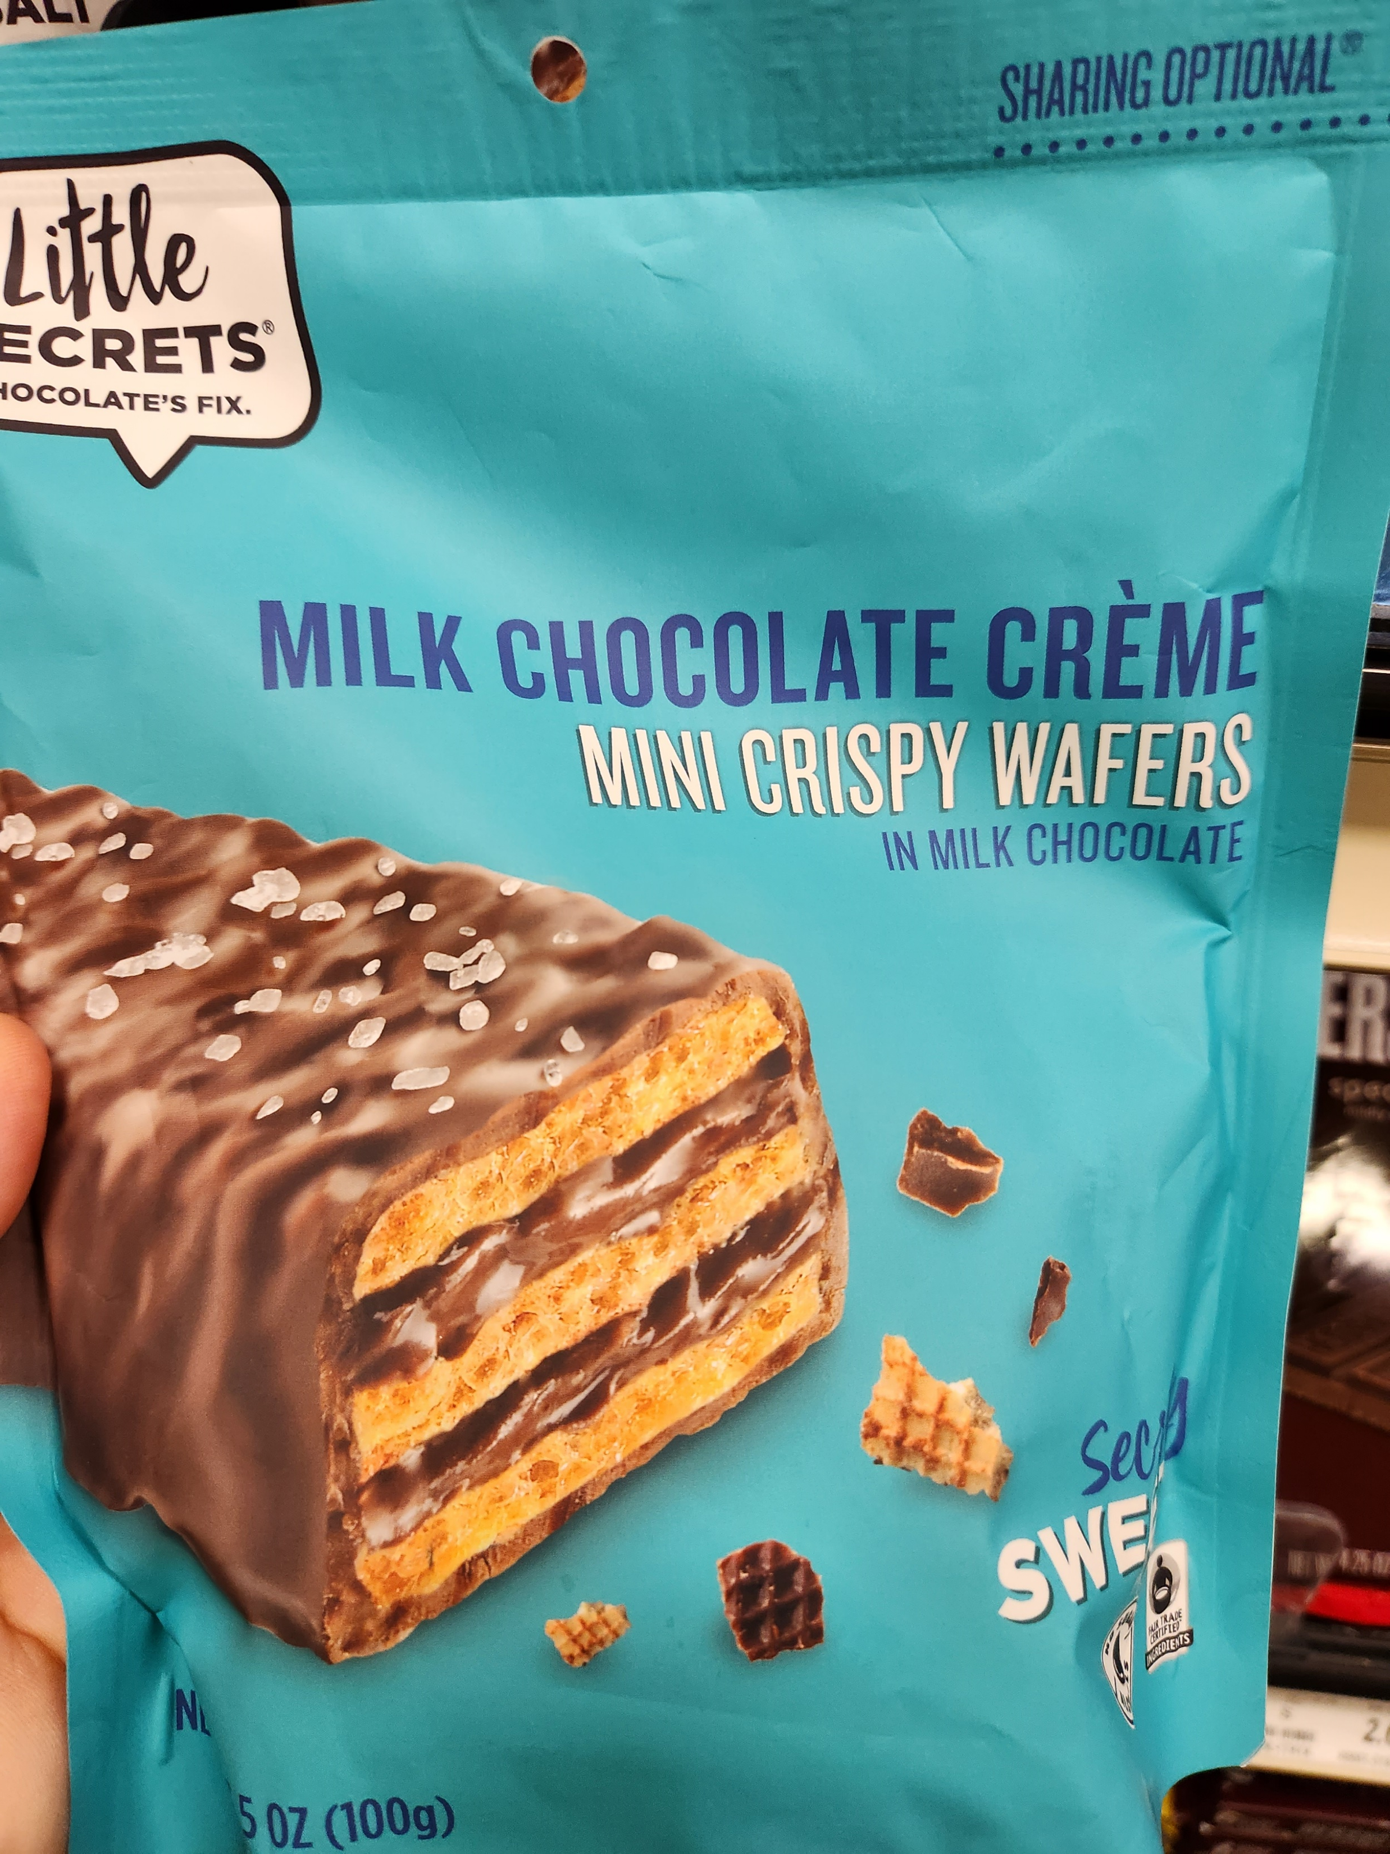
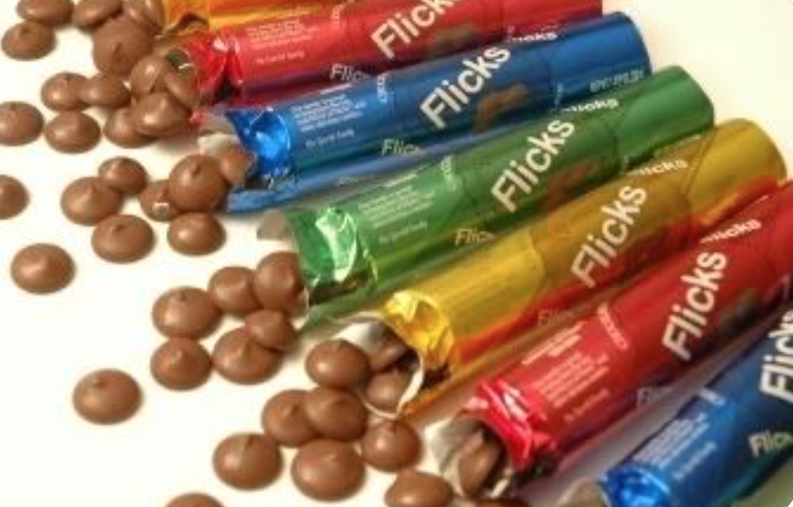
SOURCING
Reduce
Increase direct product package contact

Slide 26
SOURCING More Sustainable Sourcing
Biomass-derived (tree and crop) from Earth surface
Paperboard
Some plastics
Virgin content
OR
OR
&
Fossil-derived (oil) from inside Earth
Some plastic
Some coatings
Recycled content
OR
OR
Reused package
Earth derived (extraction) from inside Earth
Glass (sand, etc.)
Metal (bauxite, iron) derived

Slide 27
SOURCING Considerations
Environmental
LCA Considerations - Primary Energy
Greenhouse Gas Emissions
Eutrophication
Stratospheric Ozone Depletion
Loss of Biodiversity
Soil Carbon Depletion
Soil Erosion
Deforestation
Social
Food Security
Land Use Change Impacts
Local and/or Indigenous Communities
Occupational Health & Safety
Water Management
Chemical Use: Nutrients and Pest Management
Co-Product and Waste Management
Labor Rights

Slide 28
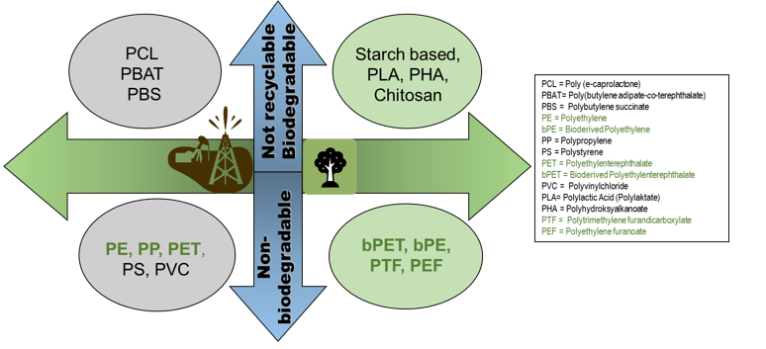
SOURCING The Alphabet

Slide 29
6 Alternate Bioderived Polymers (plus PET) in Packaging
Polyethylene Furanoate (PEF) | Polytrimethylene Furandicarboxylate (PTFDC) | Polylactic Acid (PLA) | Polyhydroxyalkanoates (PHA) | Starch-based Polymers | Chitosan
1 | 2 | 3 | 4 | 5 | 6
PEF is a polyester that consists of repeating units of furan rings connected by ethylene glycol | PTFDC is a polyester that consists of repeating units of furan rings connected by trimethylene glycol | PLA is a polyester that is derived from renewable sources, such as corn starch or sugarcane, and consists of repeating units of lactic acid | PHA is a biopolymer that is produced by bacteria through fermentation of renewable feedstocks, and its chemical structure can vary depending on the specific monomers used | Starch-based polymers are derived from renewable sources, such as corn or potato starch, and can have varying chemical structures depending on the processing and modifications | Chitosan is a natural biopolymer derived from chitin, which is a biopolymer found in the shells of crustaceans such as shrimp and crabs. Chitosan has a chemical structure that consists of repeating units of glucosamine, which is a monosaccharide composed of a glucose molecule with an amino group (-NH2) attached to it. The chemical formula for chitosan can be represented as
C10H8O6 | (C8H8O6)n | (C3H4O2)n | (C3H4O2)n | (C6H10O5)n | (C6H11NO4)n

Slide 30
Polyethylene Furanoate (PEF) C10H8O6
Application
Commercialized
PEF is used as a replacement for polyethylene terephthalate (PET) in beverage bottles due to its superior barrier properties, such as enhanced gas barrier, improved thermal stability, and better mechanical strength.
Carlsberg's Green Fiber Bottle: This is a paper bottle that is made from sustainably sourced wood fiber and lined with a thin layer of PEF. The Green Fiber Bottle is currently in a testing phase, and Carlsberg plans to release it in a limited quantity in select markets in 2023.
Danone's evian+: This is a range of flavored mineral water beverages that are packaged in bottles made from 100% recycled PET and a small amount of PEF. The PEF is used as a barrier layer to protect the product from light and oxygen.
Avantium's Dawn: This is a range of ready-to-drink (RTD) tea and coffee beverages that are packaged in bottles made from 100% PEF. Avantium is currently in the process of scaling up production of the Dawn bottles.
Coca-Cola's PlantBottle: This is a range of PET plastic bottles that are made from up to 30% plant-based materials, including PEF. The PEF is used as a barrier layer to help keep the product fresh.
PepsiCo's Green Bottle: This is a range of PET plastic bottles that are made from up to 100% plant-based materials, including PEF. The Green Bottle is currently being used for PepsiCo's Tropicana brand in select markets.
Potential
Carbonated beverages, juices, water, alcoholic beverages, sauces, dressings, oils, and other liquid food and beverages.
Manufacturers
1. Avantium (Netherlands)
2. Synvina (Netherlands)
3. Toyobo (Japan)

Slide 31
Polytrimethylene Furandicarboxylate (PTFDC) C8H8O6
Application
Manufacturers
PTFDC is used in food packaging applications such as films, coatings, and trays due to its excellent barrier properties, including oxygen barrier and moisture barrier.
1. Synvina (Netherlands)
2. Danone (France)
3. Mitsui Chemicals (Japan)
4. Toyobo (Japan)
5. Sulzer (Switzerland)
Potential
Snack foods, bakery products, dried fruits, nuts, cereals, meat, poultry, seafood, and other food items requiring extended shelf-life.
Commercialized
Not in use

Slide 32
Polylactic Acid (PLA) (C3H4O2)n
Application
Manufacturers
PLA is used in food packaging applications such as films, coatings, cups, and trays and renewable nature. It also offers good clarity and barrier properties.
Can be compostable.
1. NatureWorks LLC (USA)
2. Total Corbion PLA (Netherlands)
3. Futerro (Belgium)
4. Synbra Technology (Netherlands)
5. Mitsubishi Chemical (Japan)
Potential
Commercialized
Fresh produce packaging, dairy products, bakery items, deli foods, and other food products.
Food Service Packaging
Genpak Harvest™ Fiber: Genpak
Eco-Products GreenStripe® Hot Cups
World Centric® Cutlery: World Centric
NatureFlex™ Films: Futamura
StalkMarket® Bakery Containers

Slide 33
Polyhydroxyalkanoates (PHA) C3H4O2)n
Application
Manufacturers
PHA is used in food packaging applications due to its biodegradability, barrier properties, and versatility in processing. It can be tailored to have specific properties based on the desired packaging application.
1. Danimer Scientific (USA)
2. Bio-On (Italy)
3. Tianan Biologic Materials (China)
4. Kaneka Corporation (Japan)
5. Newlight Technologies (USA)
Potential
Fresh produce packaging, dairy products, meat, poultry, seafood, and other food items.
Commercialized
Food Service Packaging
TIPA® Compostable Produce Bags
Go Green Cutlery
Futerro Barrier Coatings

Slide 34
Starch-based Polymers (C6H10O5)n
Application
Manufacturers
Starch-based polymers are used in food packaging applications due to their biodegradability, renewability, and low cost. They can be used in a variety of forms, such as films, coatings, and trays.
1. Novamont (Italy)
2. Kuraray (formerly Plantic Technologies Australia)
3. Rodenburg Biopolymers (Netherlands)
4. Floreon (UK)
5. TIPA Corp (Israel)
Potential
Commercialized
Fresh produce packaging, dry food items, disposable cutlery, and other food products.
Food Service Packaging
Vegware® Compostable Food Packaging
TPLA Cutlery: GreenGood®
BioPBS® Films and Coatings: Mitsubishi Chemical
Mater-Bi® Fresh Produce Bags
Kuraray developments underway

Slide 35
Chitosan (C6H11NO4)n
Application
Manufacturers
Chitosan, derived from chitin, is used in food packaging applications due to its antimicrobial properties, biodegradability, and film-forming ability. It can be used as a coating or film to enhance the shelf-life of food products.
ChitoTech (USA)
ChitosanLab (Japan)
Heppe Medical Chitosan GmbH (Germany)
Primex ehf (Iceland)
Golden-Shell Pharmaceutical Co., Ltd. (China)
Potential
Fresh produce packaging, seafood, and other
Commercialized
Limited to coatings

Slide 36
SOURCING Selected Biomass Derived Polymers in Use Today

Slide 37
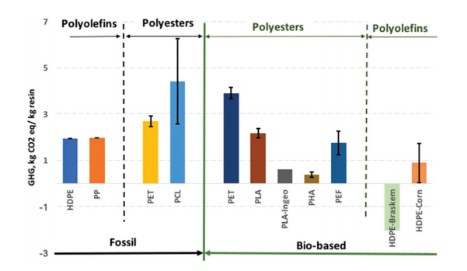
SOURCING Bioderived Polymers
Some bioderived polymers generate more GHG than oil derived polymers

Slide 38
SOURCING High Potential in Flipping the Barrier
$23,510
MasterPack Expansion
Minimal primary packaging for consumer
Reusable high-barrier MasterPacks opened to restock shelves
$294,043
$112,972
Impact
Longer shelf life from manufacturer to retailer
Consumer packaging focused on required shelf life
Less primary packaging for consumer and MSW
Potentially more recyclable primary packaging
Less food waste
$796,708
$81,406
$72,986
$366,369
$1,217

Slide 39
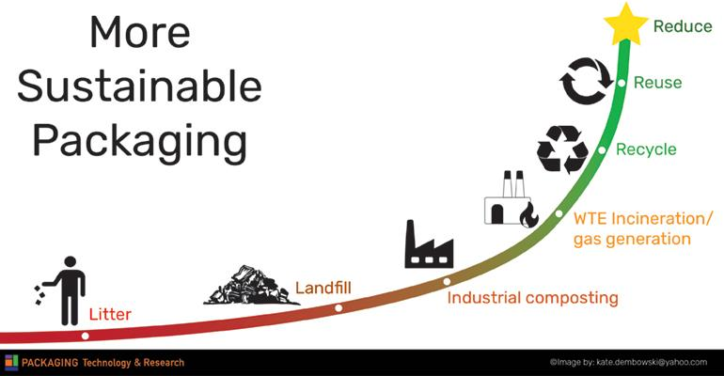
MOST SUSTAINABLE DISPOSAL

Slide 40
DISPOSAL Recyclable
Package coating and forming innovation
Product coating and wrapper coating innovation-
NESTLÉ aiming at 100% recyclable
or reusable packaging
by 2025
Design innovation-
Integrated lidding
Many ways to achieve recyclable packaging
Verified as recyclable

Slide 41
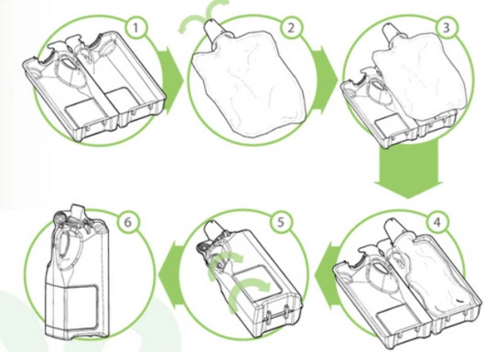
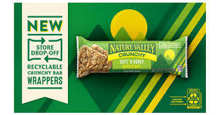
DISPOSAL Recycle Ready and SDO Recyclable Film have Untapped Potential in Candy

Slide 42
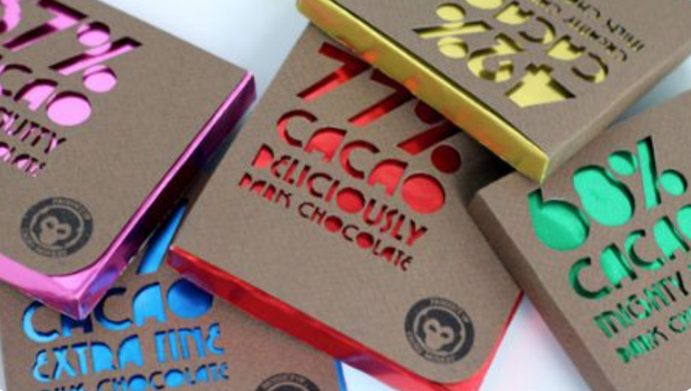
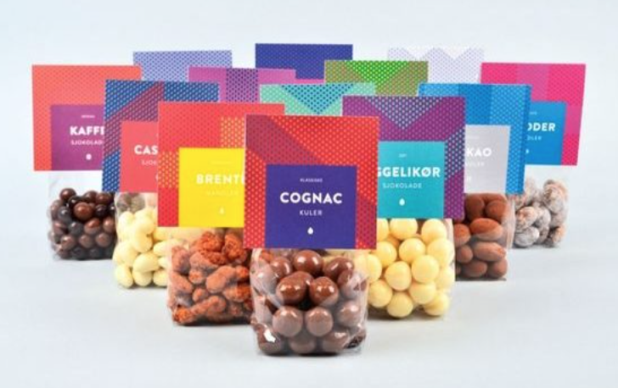
DISPOSAL Recycle ready
Recycle Ready matures to SDO – StoreDropOff Recycling
PET bag with paper top
Separable and beautiful
The guilloche pattern was magnified and enhanced with an array of oval punctures arranged as if a part of some stretched and distorted fabric. Die cut allows the foil to show through

Slide 43
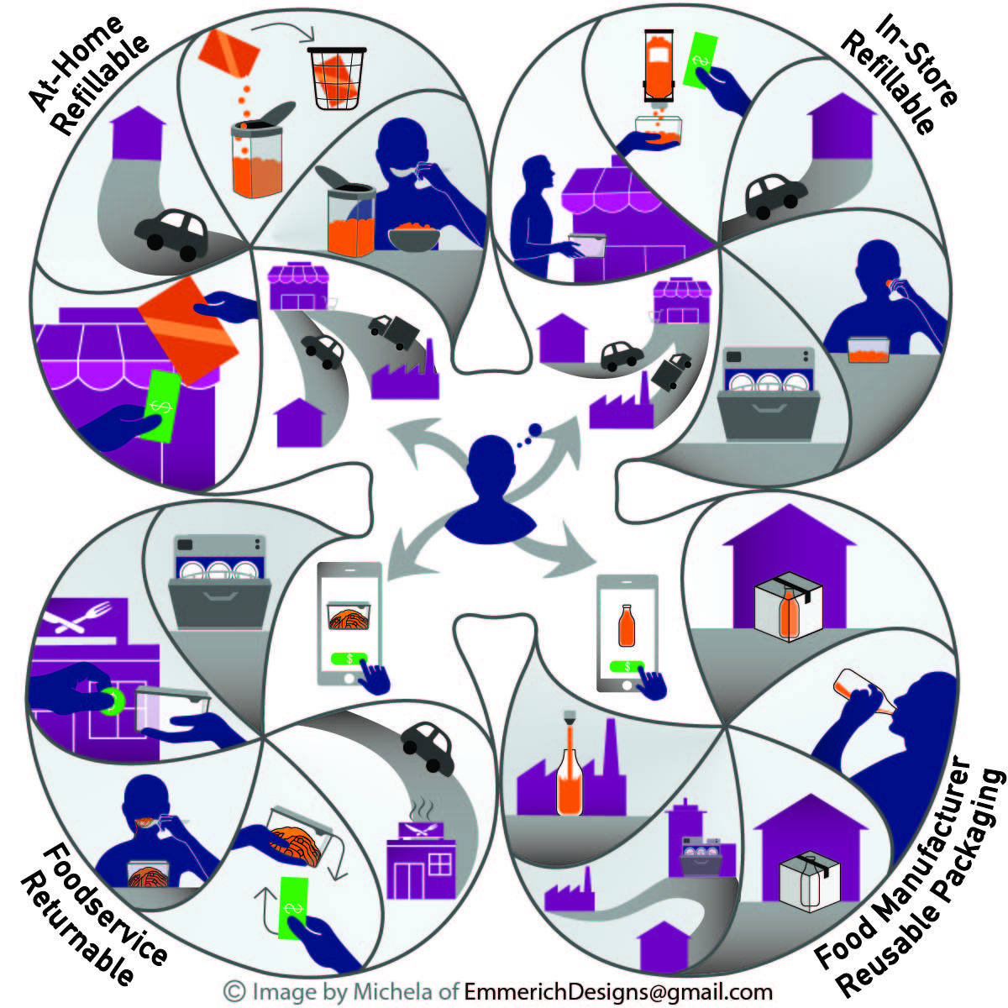
DISPOSAL Reusable Packaging
Sustainability is dependent on transport from use to reuse
Just Salad is more sustainable
OZZI is more sustainable
TerraCycle or Loop system is not more sustainable than current packaging unless within 100 miles

Slide 44
More Sustainable Packaging Take-Aways
Packaging’s role in moving the dial on a more sustainable food system is more appropriately focused on preventing food waste
More Sustainable Packaging
Where we are now demands focus on moving the dial
>Sourcing - Biomass-derived PE and PET are drop-in solutions
> Disposal - Value chain, design and systems thinking is needed
Fundamental shifts have promise

Slide 45
Fundamental Shifts will Lead to More Sustainable Packaging I Where Packaging is Heading
> Focus on a more sustainable food system
> Big Data for Democratization and Values-Based Interactions
> XR Expands Tacit Knowledge
> Beta-Packaging Provides Agility
> AI to Achieve Planet-Centered Design
> Value Chain approaches to addressing Chemicals of Concern

Slide 46
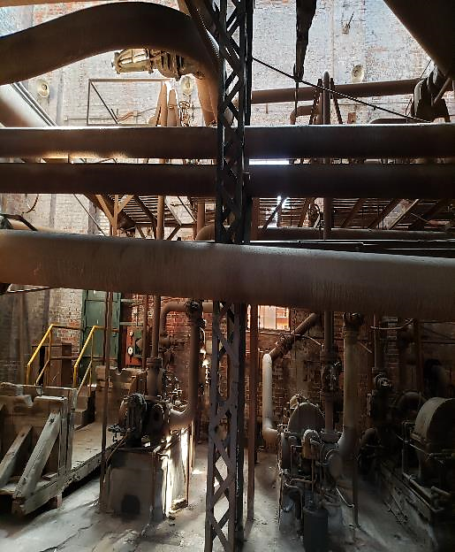
Fundamental Shifts will Lead to More Sustainable Packaging Business Cases Align
Externalities
Natural disasters (drought, fires, flood, typhoon, hurricane, tornado)
Human struggles (virus, famine, political upheaval)
Power reliability (outages, internet, production)
Variable sustainability pressures (bans, taxes, policies)
Internalities
Space external to retail
Planogram issues
Labor
OOS
Restocking innovation needed
Cannot meet exact consumer need for size and product
Intense shifts in value chain drivers
Externalities
Natural disasters (drought, fires, flood, typhoon, hurricane, tornado)
Human struggles (virus, famine, political upheaval)
Power reliability (outages, internet, production)
Variable sustainability pressures (bans, taxes, policies)

Slide 47
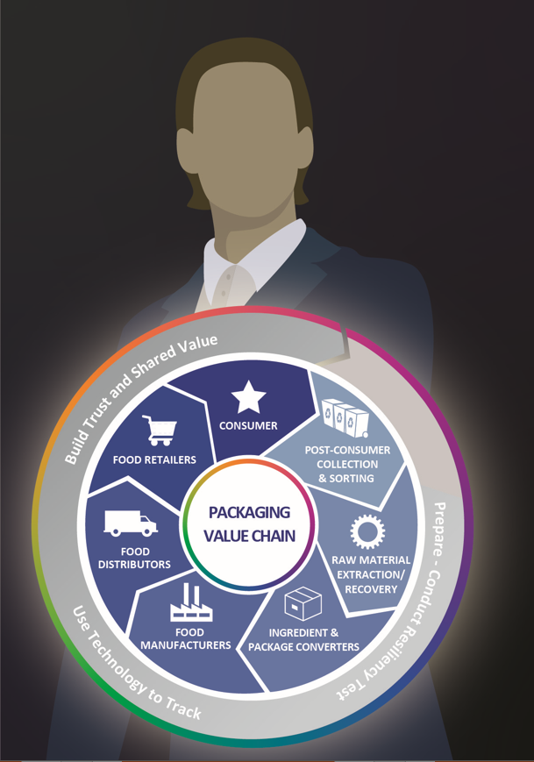
Fundamental Shifts will Lead to More Sustainable Packaging Beta Packaging bring Agility
Beta design:
Beta-packaging focuses on agility
Incorporates 5th industrial revolution
Generative use-focused design
Allows retailers and consumers to adjust package
Packaging that senses then acts
Aligns with inherent variability of our food system

Slide 48
Fundamental Shifts will Lead to More Sustainable Packaging l Beta Packaging – Packaging that Changes the Product
Technology
Consumer View
Business Case
Release of ingredients by the package 2ndary addition of ingredients – similar to salads made BOH in store now | Formulations defined by the package Consistent product Protected ingredients | Aligns with production efficiencies Logistics stress transferred from production Adjust packaging vs product

Slide 49
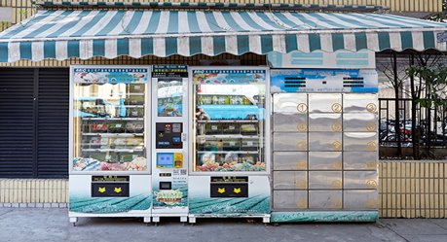
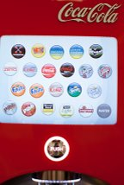
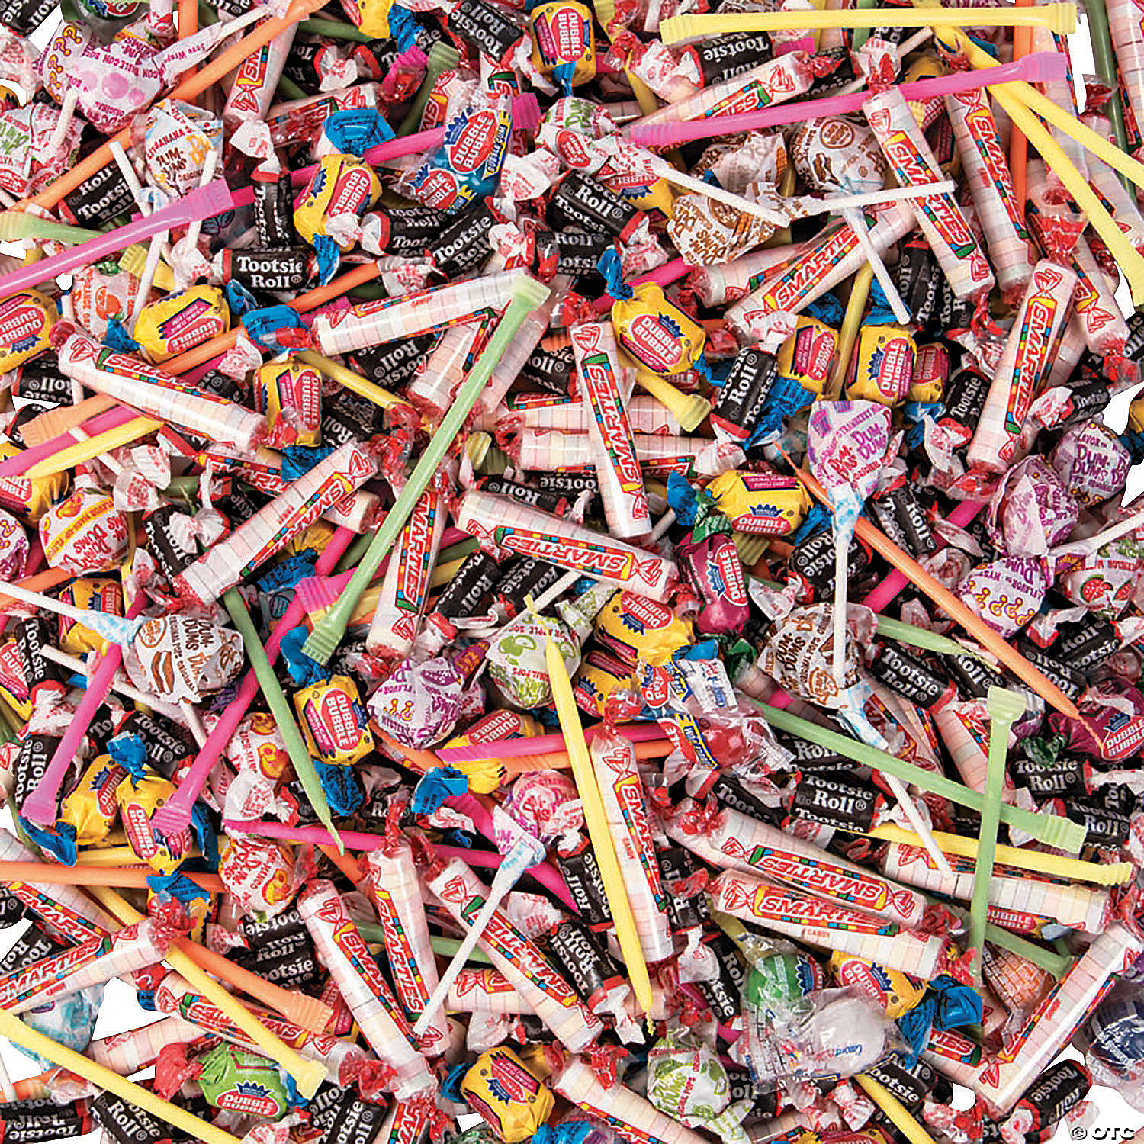
Fundamental Shifts will Lead to More Sustainable Packaging I Packaging Value Chain Innovation
Factory in the Store
Mobile factories replace ice cream trucks
Direct to consumer delivery
Self serve bins
Align with grocerants

Slide 50
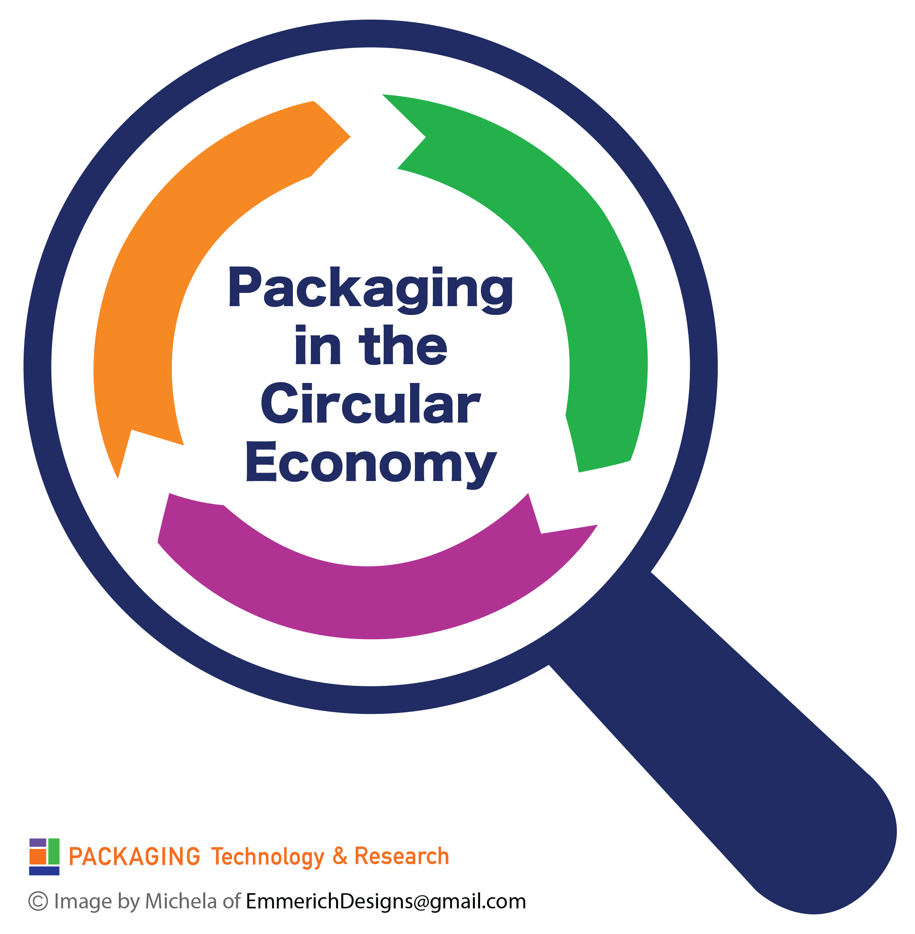
SOURCING
Clean Packaging
Packaging is approved based on its defined use
Over 10,000 chemicals are approved for direct food contact
Many are linked to cancer, endocrine disruption, health and environment
Alternatives to Tier 1, 2 and 3 chemicals are being implemented
Clean packaging allows for a safe circular economy

Slide 51
Fundamental Shifts will Lead to More Sustainable Packaging I Chemicals of Concern are Being Addressed
Hiding behind regulations catches many off-guard
Shape-shifting supply chain
Regrettable substitutions exist
Industry experts know that substitutions may be regrettable
This is a costly, and time-consuming game of whack-a-mole
Data was hidden from FDA
GRAS status is dubious
Harmonious regulatory action is delayed
Reliance on voluntary abandonments
Snapshot do not protect brands or
consumers
Extensive incoming inspection is costly and is not in alignment
Hodge-podge of local and retailer bans

Slide 52
Fundamental Shifts will Lead to More Sustainable Packaging I Sources of PFAS Primary Packaging
Primary Packaging | Tertiary Packaging | Ingredients | Production Environment
1
2
4
2
3
Impart Improved Barrier
Release Agents | Forming Polymers | Improved Barriers | Grease/ Oil Resistance
For Thermoforming, blowmolding | Wetting and leveling agents, emulsifiers, foaming agents, or dispersants | Flourination of PE was approved in 1983 | Dry end coatings on paperboard and corrugated, and paper Lower the surface tension
 | Emulsifiers assist in producing Teflon Examples include the use of PFOA | Used during forming of in HPDE, PP, PET blowmolded, thermoformed containers | Wet end use on paperboard
 | Bond with functional groups such as acids and alcohols and/or take part in condensation polymerization of Nylon and PET | Primarily Polyﬂuoroalkyl substances | Coatings on hydroscopic polymers such as PLA, cellulose, starch, ethylenes, etc..
 |  | Polymers fluorinated with hexaﬂuoropropylene (HFP), tetraﬂuoroethylene (TFE), vinylidene ﬂuoride (VDF) polymers | Packaging for Pet food, bakery, FOH fried foods

Slide 53
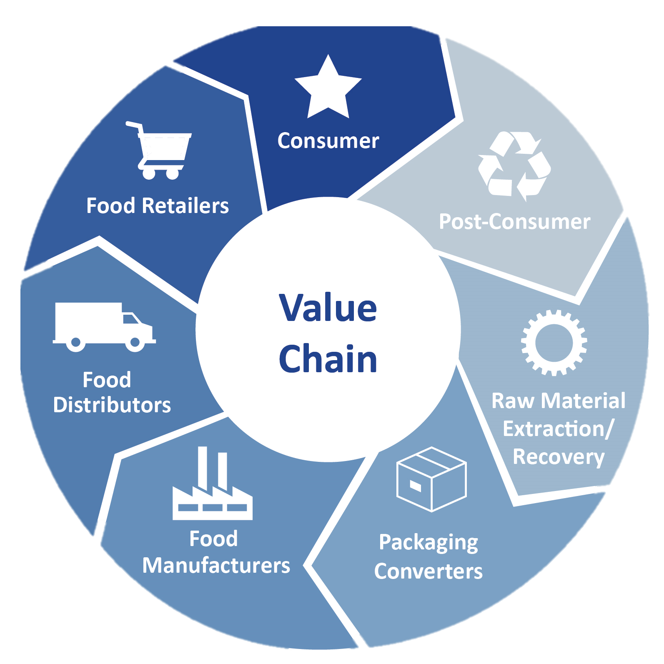
Fundamental Shifts will Lead to More Sustainable Packaging I Value Chain provides the opportunity to…Future Proof Packaging
Proactively Plan for the Future - Avoid kicking the can down the road with regrettable substitutions
Build a more valued safety-focused relationship with regulatory agencies
Build/rebuild Trust in all entities of the packaging value chain
Align vs Entrap value chain partners
Future Proof
Packaging Value Chain
Future-Proofed Packaging Value Chain
Future Proof
Packaging Value Chain

Slide 54
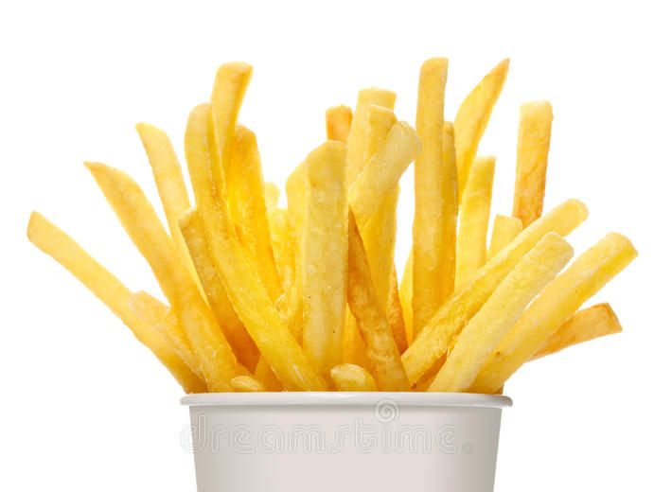
Fundamental Shifts will Lead to More Sustainable Packaging I A Future Proof Packaging Approach Case Studies
Package redesign to
Employ a removeable plastic liner within FOH cartons
FOH cartons with a sealed low point with an adsorbent substance
FOH cartons dusted with an adsorbent substance
PFAS sensors on packaging for value chain use
System solutions to replace for oil and grease resistance need in FOH QSR french fry cartons
Reduce oil in contact with packaging via a systems approach using one or all of these solutions
Reformulate fries to
Enhanced PME-based oil resistance so that less oil is adsorbed
BOH Processing to
Adsorb oil prior to FOH packaging with diatomaceous earth or food grade clays
Use a 2-phase system in which oil is drained more extensively at a station before final FOH packaging
Non-PFAS plastic (reusable) packaging

Slide 55
More Sustainable Packaging Take-Aways
Packaging’s role in moving the dial on a more sustainable food system is more appropriately focused on preventing food waste
More Sustainable Packaging
Where we are now demands focus on moving the dial
>Sourcing - Biomass-derived PE and PET are drop-in solutions
> Disposal - Value chain, design and systems thinking is needed
Fundamental shifts have promise

