Slide 1
Understanding PFAS: Regulations, Sources, Chemistry, and Alternatives

Slide 2
Agenda
Introductions & Housekeeping
Polling Question
Walter Brandl
Polling Question
Dr. Claire Sand
Questions & Answers

Slide 3
Introductions & Housekeeping

Slide 4
Housekeeping Reminders
You will receive a copy of the recorded presentation of today’s webinar within 1-2 days
Submit your questions in the Gotowebinar Control Panel

Slide 5
Learning Objectives
Understand the FDA’s regulatory requirements for PFAS
Learn the alternatives to PFAS, and how to prevent new PFAS
Understand the chemistry and sources of PFAS

Slide 6
Presenter Introductions
Walter Brandl
Regional Director of Chemistry
Mérieux NutriSciences
Dr. Claire Sand
Founder & Owner Packaging Technology & Research
Adjunct Professor, Michigan State University and CalPoly

Slide 7
Polling Question:
Where does addressing PFAS rank on your priorities list for 2023?

Slide 8
What is a PFA?
The per-and polyfluoroalkyl substances (PFAS) are a group of chemicals used to make fluoropolymer coatings and products that resist heat, oil, stains, grease, and water. Fluoropolymer coatings can be in a variety of products. These include clothing, furniture, adhesives, food packaging, heat-resistant non-stick cooking surfaces, and the insulation of electrical wire. Many PFAS, including perfluorooctane sulfonic acid (PFOS) and perfluorooctanoic acid (PFOA), are a concern because they:
do not break down in the environment,
can move through soils and contaminate drinking water sources,
build up (bioaccumulate) in fish and wildlife.
Source: Center for Disease Control and Prevention
Reference: https://www.fda.gov/food/cfsan-constituent-updates/fda-makes-available-pfas-testing-results-first-survey-processed-foods

Slide 9
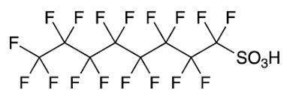
What is a PFA?
Reference: https://www.fda.gov/food/cfsan-constituent-updates/fda-makes-available-pfas-testing-results-first-survey-processed-foods
PFOA
PFOS

Slide 10
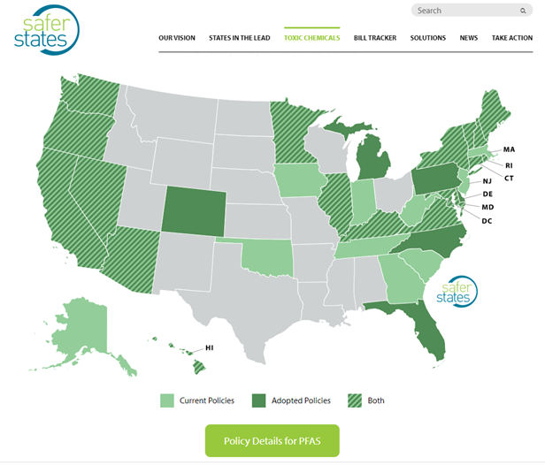
US State Regulatory Activities - PFAs
Chemical hazards - PFAs
Several states passed legislation or proposed bans of the use of perfluoroalkyl and polyfluoroalkyl substances (PFAS) in food and cosmetic packaging. (https://www.saferstates.com/toxic-chemicals/pfas/)
EPA set health advisory for 4 PFAs in drinking water
EPA lists PFAs on Toxic Release Inventory
Class action law suits for companies claiming “natural” with PFAs

Slide 11
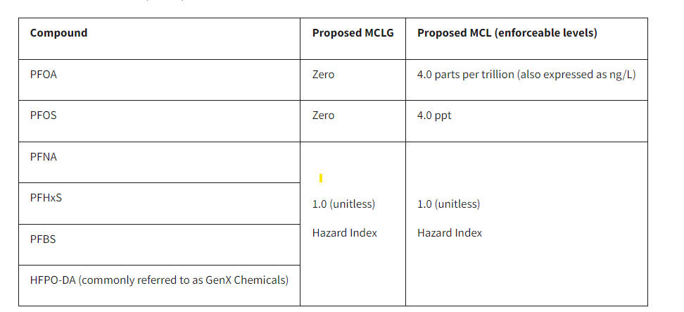
US Drinking Water
Reference: https://oehha.ca.gov/proposition-65/proposition-65-list

Slide 12
Canada
2018 Guidelines for Canadian Drinking Water Quality
Set limits for 9 PFAs in drinking water
Set limits for 11 PFAs in soil
PFOs in fish tissue and bird eggs
2021 The Gazette published that the Government of Canada will:
Continue to invest in research and monitoring on PFAS;
Collect and examine information on PFAS to inform a class-based approach; and
Review policy developments in other jurisdictions.

Slide 13
Canada

Slide 14
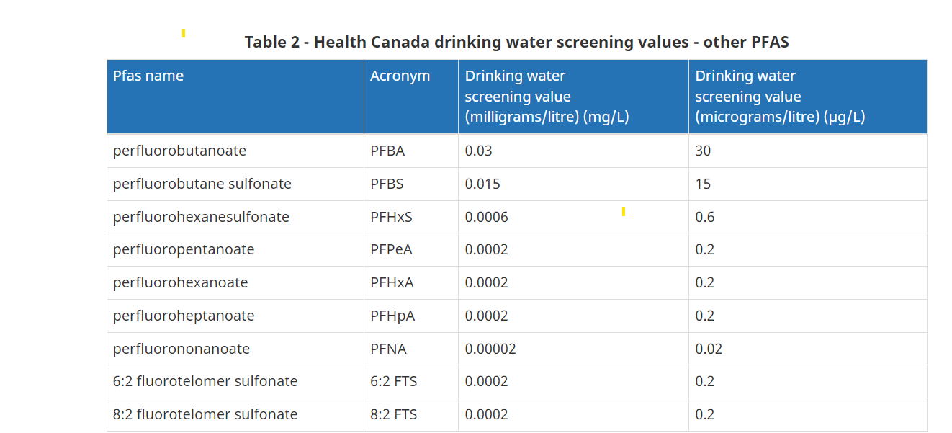
Canada

Slide 15
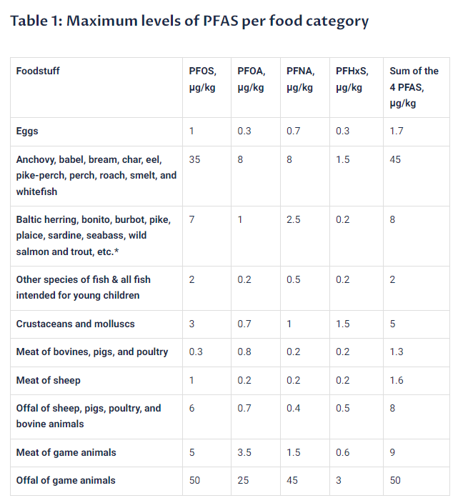
European Union

Slide 16
Analysis of PFAS
In choosing methods of analysis for PFAS we can go from the generic to the specific
Total Fluorine
Total Organic Fluorine
PFAS groups or families
targeted, individual specific PFAS compounds
non-targeted, all-inclusive screen
In general as specificity increases, cost and time to result also increases

Slide 17
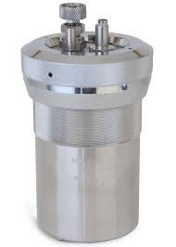
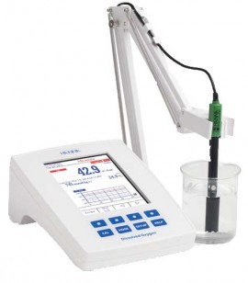
Analysis of PFAS
Total Fluorine
Sample pre-treatment is a combustion reaction to free up the fluorine from the matrix
Free fluoride is water soluble
Determination of fluoride can be made by selective ion electrode or ion chromatography

Slide 18
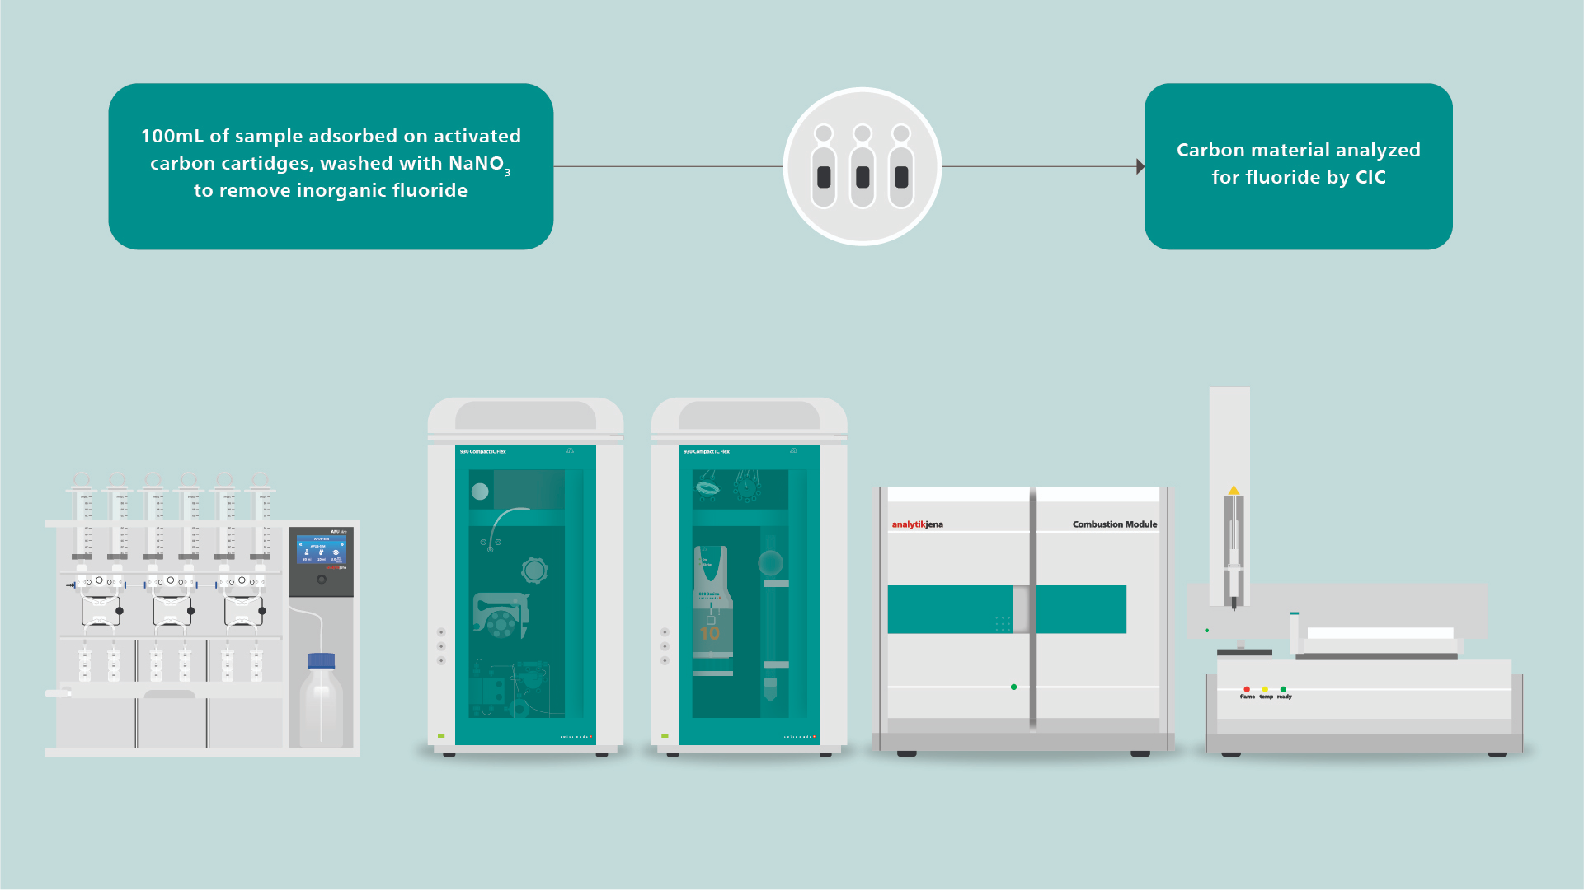
Analysis of PFAS
Total Organic Fluorine
Sample pre-treatment involves adsorption or extraction of the fluoride compounds, removal of inorganic fluoride
Determination of fluoride can be made by selective ion electrode or ion chromatography

Slide 19
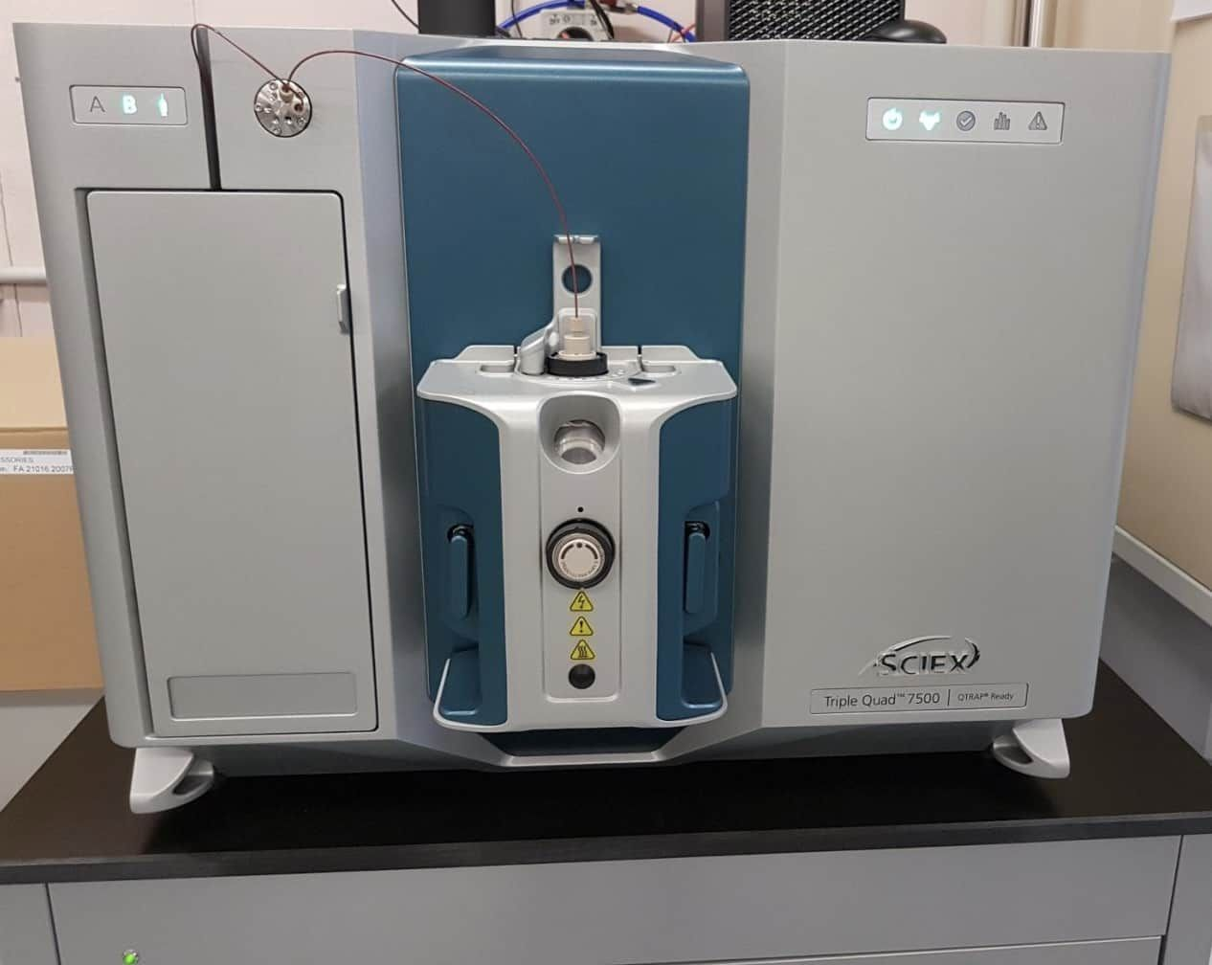
Analysis of PFAS
Determination of PFAS groups or specific PFAS compounds
Solvent extraction followed by solid phase clean-up.
Addition of Internal Standards
Determination by HPLC tandem mass spectrometer (LC-MSMS)
Sensitive and specific enough for current regulations (single digit ppt or lower)

Slide 20
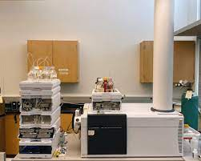
Analysis of PFAS
Detection of non-targeted PFAS compounds using Accurate Mass LC-MS
In general, qualitative analysis but quant can happen later
Allows for retrospective searches as the mass data can be stored for future analysis
Typically less sensitive than LC-MSMS
Can be used for confirmation of poorly resolved peaks

Slide 21
Analysis of PFAS
Technique | Application | Comments
Total Fluoride | Screening packaging, firefighting foams | fast, 2-10 ppb in water,
Total Organic Fluorine | Screening of packaging, textiles, sediments
Targeted PFAS | foods, potable water, | regulatory compliant, sensitive and specific
non-targeted PFAS | risk assessment

Slide 22
Polling Question:
In what areas are you addressing PFAS in 2023?

Slide 23
Key Takeaways
PFAS regulations are creating stress
1
3
Industry has worked hard with a fragmented approach and alternatives to PFAS face roadblocks
PFAS sources in food are from production, processing and packaging
2
4
Future Proof Packaging is needed to avoid the pitfalls of a fragmented approach

Slide 24
Selected Sources of PFAS in Packaging
Primary Packaging | Tertiary Packaging | Ingredients | Production Environment
1
2
3
4

Slide 25
Selected Sources of PFAS Primary Packaging
Primary Packaging | Tertiary Packaging | Ingredients | Production Environment
1
2
3
4
Impart Improved Barrier
Release Agents | Forming Polymers | Improved Barriers | Grease/ Oil Resistance
For Thermoforming, blowmolding | Wetting and leveling agents, emulsifiers, foaming agents, or dispersants | Fluorination of PE was approved in 1983 | Dry end coatings on paperboard and corrugated, and paper Lower the surface tension
 | Emulsifiers assist in producing Teflon examples include the use of PFOA | Now used during forming of in HPDE, PP, PET blowmolded, thermoformed containers | Wet end use on paperboard
 | Bond with functional groups such as acids and alcohols and/or take part in condensation polymerization of Nylon and PET | Primarily Polyﬂuoroalkyl substances | Coatings on hydroscopic polymers such as PLA, cellulose, starch, ethylenes, etc.
 |  | Polymers fluorinated with hexaﬂuoropropylene (HFP), tetraﬂuoroethylene (TFE), vinylidene ﬂuoride (VDF) polymers | Packaging for Pet food, bakery, FOH fried foods

Slide 26
Selected Sources of PFAS Tertiary Packaging
Primary Packaging | Tertiary Packaging | Ingredients | Production Environment
1
2
3
4
Packaging containing PFAS can come in contact with and then contaminate other packaging that has direct contact with food
Migration into food can occur through secondary packaging such as labels, coatings, and cartons into food
Handling of secondary packaging and then food in second-stage BOH/Production environments can contaminate food

Slide 27
Selected Sources of PFAS Ingredients
Primary Packaging | Tertiary Packaging | Ingredients | Production Environment
1
2
3
4
Reusable packaging for bulk ingredient transport
Includes totes, bags, liners, barrels, and bins
Contamination of reusable totes occurs from prior use of PFAS contaminated ingredients
Abrasion increases surface area and sites for subsequent migration
Reuse increases migration due to contact time
Single-use packaging for bulk ingredient transport
Totes, bags, liners, barrels, and bins

Slide 28
Selected Sources of PFAS Production
Primary Packaging | Tertiary Packaging | Ingredients | Production Environment
1
2
3
4
Equipment used to form packaging
• Cartoners, labelers, conveyors, thermoformers, unnesters, unscramblers inhibit sticking and make production line move smoother/faster.
Production equipment used in food processing
• Extruders, ingredient conveyance systems, hoppers, mixers
• PTFE (Teflon-Polytetrafluoroethylene) is use for food processing equipment
Water and CIP cleaning agents

Slide 29
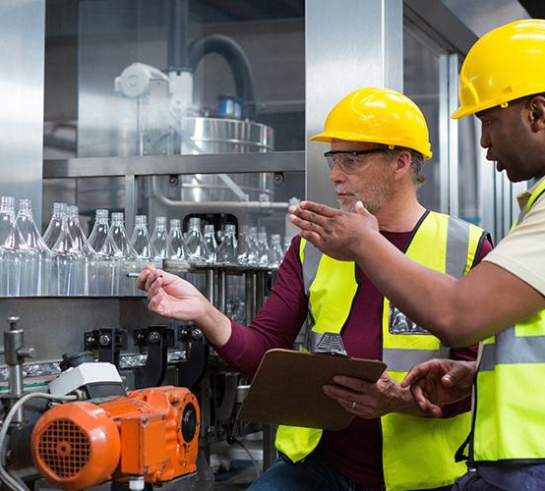
Industry Response has been Fragmented with Drop-in Solutions

Slide 30
Roadblocks hinder many Drop In Solutions
Release Agent Alternatives
Forming Polymers Alternatives
Improved Barrier Alternatives
Improved Barrier Alternatives
For many options, there are unintended consequences and/or regrettable alternatives in switching to the still approved SCPFAS

Slide 31
Roadblocks hinder many Drop In Solutions
Release Agent Alternatives
Forming Polymers Alternatives
Improved Barrier Alternatives
Improved Barrier Alternatives
Release Agent Alternatives
Silicone resins and elastomers as release agents
CAS 7473-98-5, 155419-56-0, 2855-27-8, 102782-94-5, 917773-10-5

Slide 32
Roadblocks hinder many Drop In Solutions
Release Agent Alternatives
Forming Polymers Alternatives
Improved Barrier Alternatives
Improved Barrier Alternatives
Forming Polymers Alternatives
Alternatives to polymers have a host of chemicals of concern beyond PFAs
Biodegradable alternatives are very problematic

Slide 33
Roadblocks hinder many Drop In Solutions
Release Agent Alternatives
Forming Polymers Alternatives
Improved Barrier Alternatives
Improved Barrier Alternatives
Improved Barrier Alternatives
Water barriers - alkyl succinic anhydride (ASA), styrene acrylic emulsion (SAE), alkyl ketene dimer (AKD) and rosin cannot be produced in sufficient volumes and are cost prohibitive now
Biopolymer PTF and synthetic polymer of PEN is promising

Slide 34
Roadblocks hinder many Drop In Solutions
Release Agent Alternatives
Forming Polymers Alternatives
Improved Barrier Alternatives
Improved Barrier Alternatives
Impart Grease / Oil Resistance Alternatives
Increased density with cellulose, carbon nanofibers, starch coatings during calendaring results in 20-30% slower production
Waxes or Polymer atomization, finishes, coatings may interfere with recycling
Removable and non-removeable plastic liners are not recyclable w/o SDO

Slide 35
Despite Industry efforts, PFAS is Still a Concern
Hiding behind FDA compliance is not protection
Shape-shifting supply chain
Regrettable substitutions exist
Industry experts know that substitutions may be regrettable
This is a costly, and time-consuming game of whack-a-mole
Data was hidden from FDA
GRAS status is dubious
Delayed action continues
Reliance on voluntary abandonments
Snapshot do not protect brands or
consumers
Extensive incoming inspection is costly and is not in alignment
Hodge-podge of local and retailer bans

Slide 36
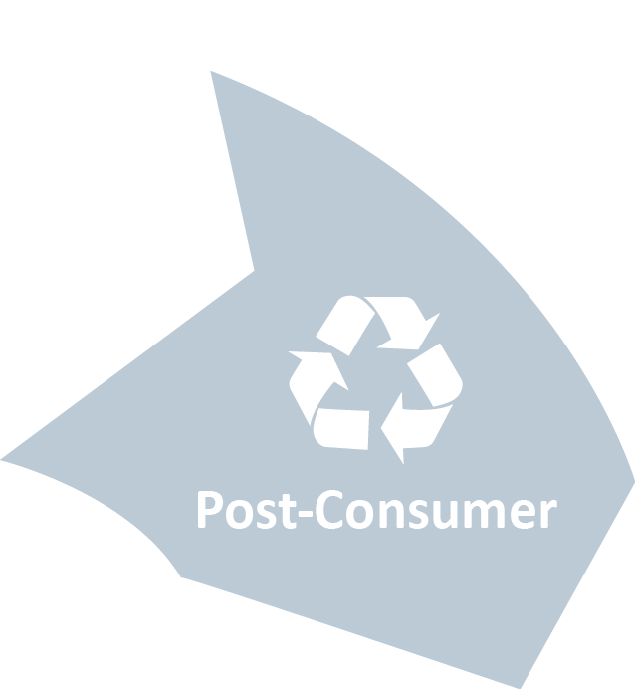
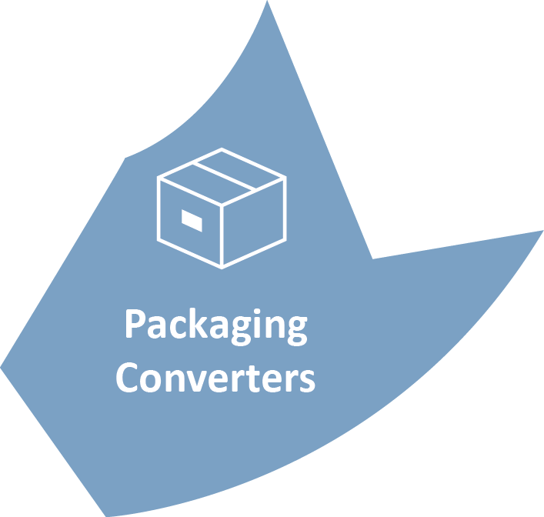
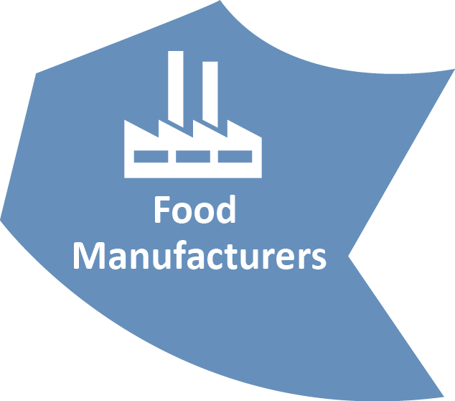
Despite Industry efforts, PFAS is Still a Concern
Value
Chain

Slide 37
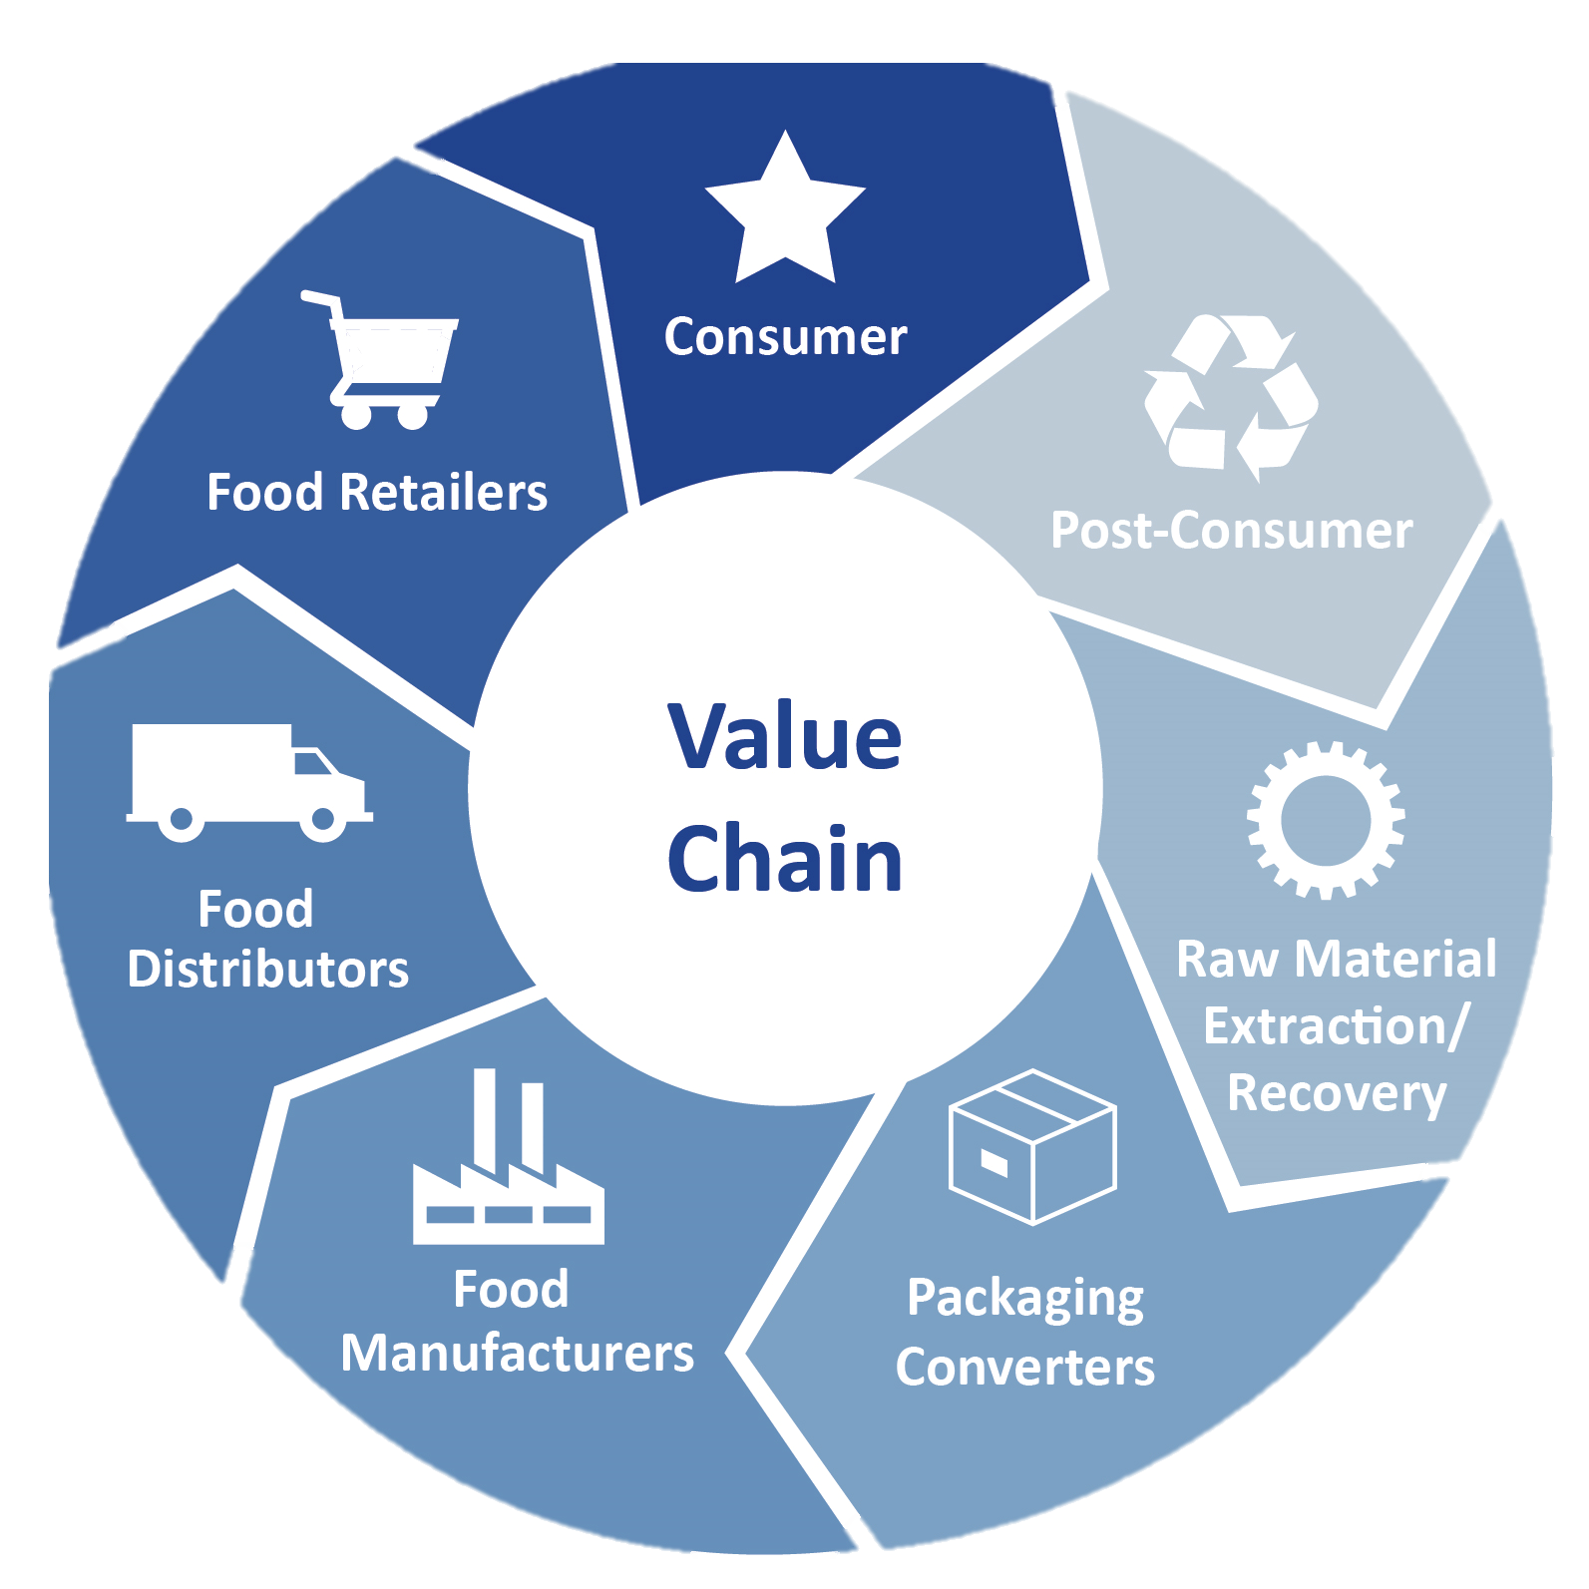
The Value Chain provides the opportunity to Future Proof Packaging
Future Proof
Packaging Value Chain
Future Proof
Packaging Value Chain

Slide 38
Value Chain provides the opportunity to…
Future Proof Packaging
Proactively Plan for the Future - Avoid kicking the can down the road with regrettable substitutions
Build a more valued safety-focused relationship with regulatory agencies
Build/rebuild Trust in all entities of the packaging value chain
Align vs Entrap value chain partners
Future Proof
Packaging Value Chain
Future-Proofed Packaging Value Chain
Future Proof
Packaging Value Chain

Slide 39
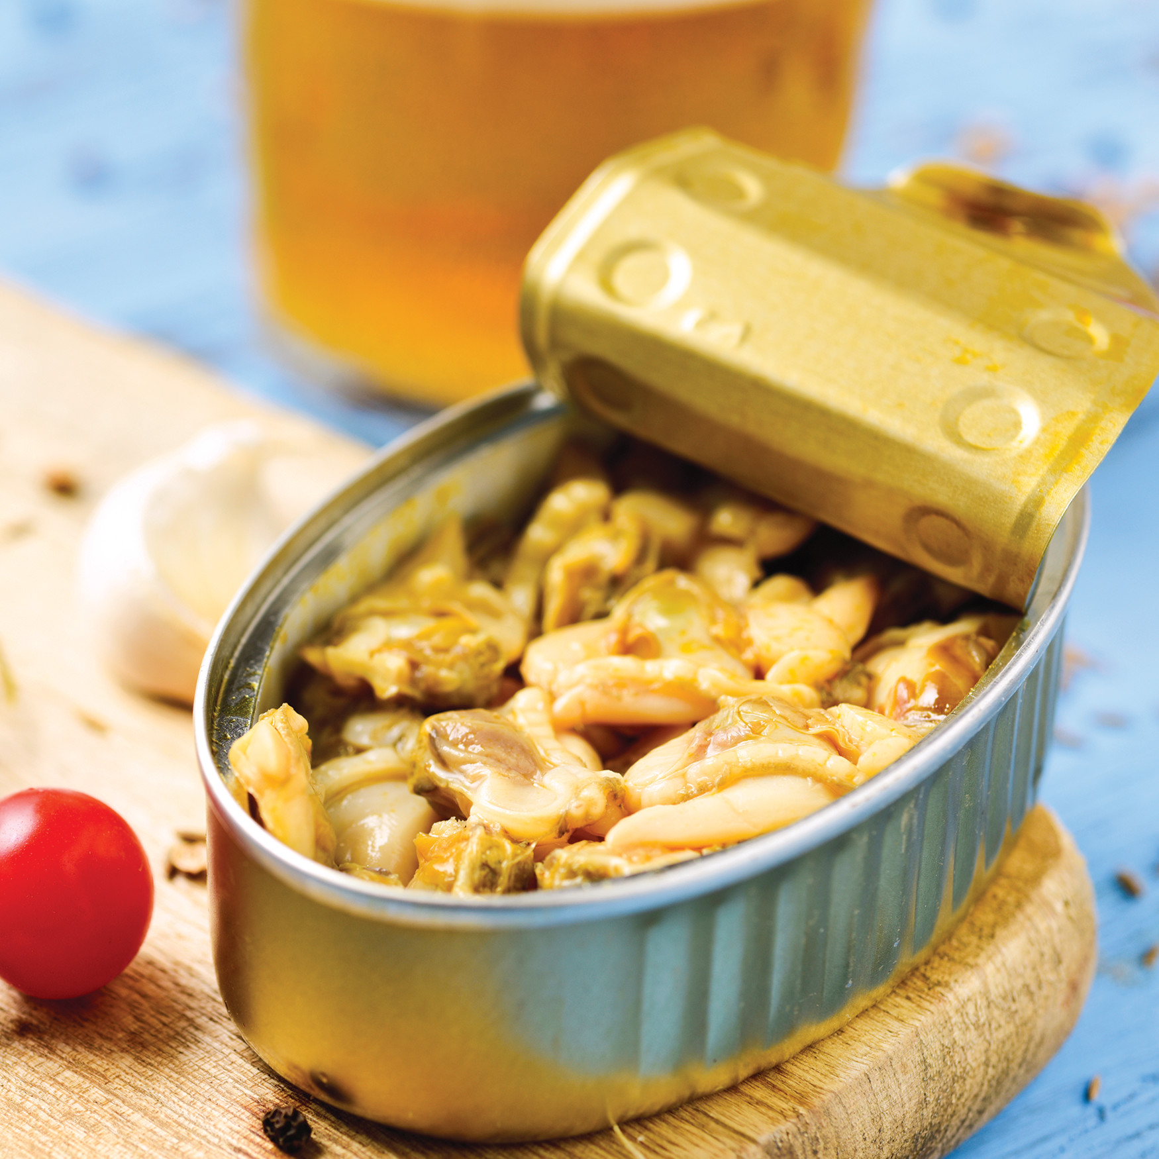
Case Studies

Slide 40
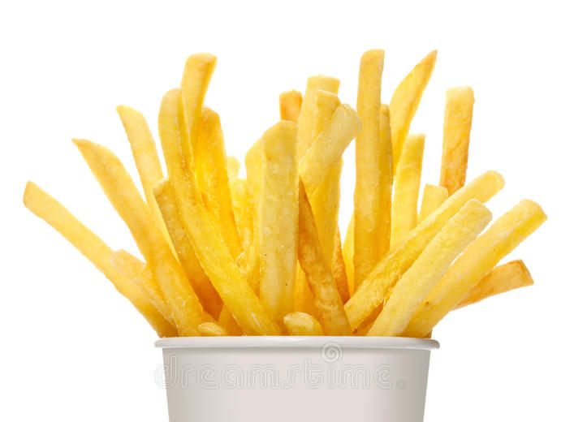
Future Proof Packaging Approach Case Studies
Non-PFAS plastic (reusable) packaging
Package redesign to
Employ a removeable plastic liner within FOH cartons
FOH cartons with a sealed low point with an adsorbent substance
FOH cartons dusted with an adsorbent substance
PFAS sensors on packaging for value chain use
System solutions to replace for oil and grease resistance need in FOH QSR french fry cartons
Reduce oil in contact with packaging via a systems approach using one or all of these solutions
Reformulate fries to
Enhanced PME-based oil resistance so that less oil is adsorbed
BOH Processing to
Adsorb oil prior to FOH packaging with diatomaceous earth or food grade clays
Use a 2-phase system in which oil is drained more extensively at a station before final FOH packaging

Slide 41
Future Proof Packaging Approach Case Studies
3. Reduce what needs to be controlled
Combine secondary and primary packaging investment for overall less packaging to monitor
4. Implement Intelligent packaging
PFAS sensors on packaging for value chain of custody
Reduce need for a high barrier in direct product contact via a systems approach using one or all of these solutions:
1. Advance Barrier technology from 1990s into 2020s
Provide barrier with enhanced polymer technology in the form of PTF, PEF, or PEN
Nanoclays to increase tortuosity
Barrier layers of EVOH, SiOx
Waxes – but this interferes with recycling
2. Flip the barrier
Food contact packaging with minimal barrier
Provide secondary packaging with enhanced barrier

Slide 42
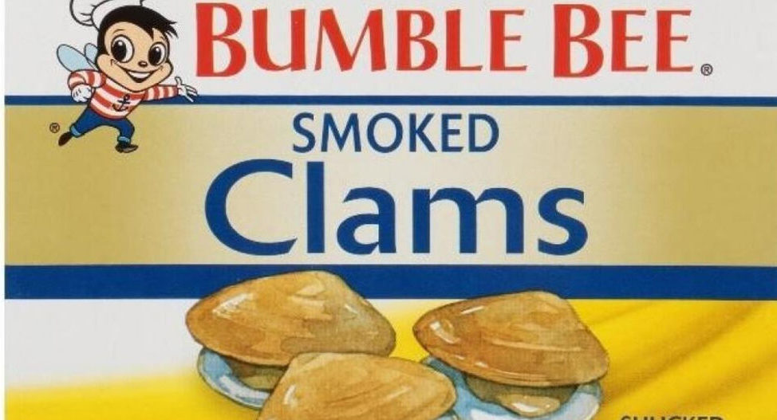
Future Proof Packaging Approach Case Studies
Reduce PFAS from contaminated water and feed in all seafood
Align with other stakeholders and take shared responsibility
This is instead of – “whew, the pressure of off packaging PFAS is everywhere!”
Work to define sources and then mitigate those sources
Engage seafood workers in re-engaging to earn a living in working on PFAS-free fishery development
Clean-up water
Engage to clean-up fisheries at issue so people can earn a sustainable living and sell safe seafood
Manage knowledge
Link solutions with packaging that communicates “products with no PFAS”
Define what is needed to provide assurances of “no PFAS”

Slide 43
Key Takeaways
PFAS regulations are creating stress
1
3
Industry has worked hard with a fragmented approach and alternatives to PFAS face roadblocks
PFAS sources in food are from production, processing and packaging
2
4
Future Proof Packaging is needed to avoid the pitfalls of a fragmented approach

Slide 44
Q&A Session
Please submit your questions in the GoToWebinar control panel

Slide 45
Thank you
Walter Brandl
walter.brandl@mxns.com
Regional Director of Chemistry
Mérieux NutriSciences
Dr. Claire Sand
Founder & Owner Packaging Technology & Research
Adjunct Professor, Michigan State University and CalPoly
Reach out to
connect for
a virtual coffee

