Slide 1
Implications of shelf life at the extremes
Defining the value chain benefits of packaging that drastically increases or decreases product shelf life
Claire Sand & Ziynet Boz

Slide 2
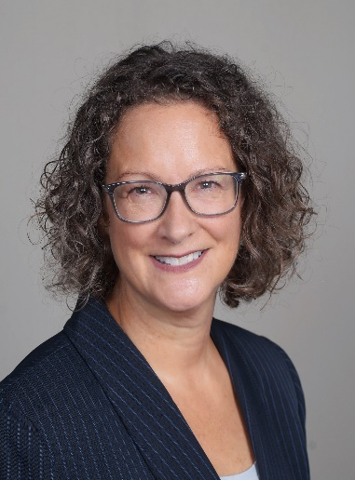








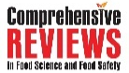





ABOUT PTR
Dr. Claire Sand thinks “all food packaging all the time”
Claire’s mission is to enable a more sustainable food system with science and value chain innovations that more sustainably increases food shelf life and prevents food waste
35+ years of food packaging experience
Ranks innovative packaging science and value chain solutions to extend shelf life
Generates implementation roadmaps and aligns business cases
IFT Fellow, Riester-Davis-Brody life-time achievement in food packaging award recipient
Doctorate in Food Science and Nutrition at University of Minnesota
MS and BS in Packaging at Michigan State University
Owner
Adjunct
Professor
Monthly
Columnist
Current Leadership & Editorial Boards
Recent
Awards
CoChair
Consortium on
Food Waste
Advisor
Food Waste Repackaged
Executive Board
Riester-Davis-Brody
Food Packaging
Lifetime Achievement Award
Editorial Board
Associate Editor
Reviewer
National Science Foundation
Editorial Board
IFT Fellow
612.807.5341 / claire@packagingtechnologyandresearch.com / PackagingTechnologyAndResearch.com

Slide 3









ABOUT PTR l
What we do
Technology
Business Case Building
Prevent Food Waste
Build Innovation RoadMaps
Provide tailored packaging
science & value chain solutions to the
food & packaging industry
Tactical
Implementation Support
Science-based Coaching
Align Value Chain
Screen Technologies
Build Internal
Knowledge
Solve Package Sustainability Puzzle
Science-based Infusion
612.807.5341 / claire@packagingtechnologyandresearch.com / PackagingTechnologyAndResearch.com
612.807.5341 / claire@packagingtechnologyandresearch.com / PackagingTechnologyAndResearch.com

Slide 4
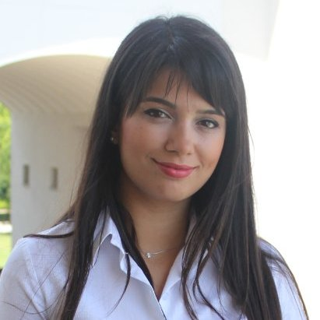

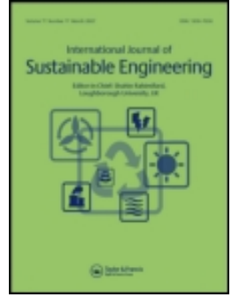


ABOUT UFL
Dr. Ziynet Boz is amazing…
Ziynet is committed to tackling challenges related to the sustainability of food systems through engineering principles.
Her current research addresses:
Food loss and waste mitigation strategies and solutions at various value chain levels (E.g., retail and consumer) through processing and packaging,
Valorization of waste into bioproducts, optimization, and modeling to improve sustainability and shelf-life of food systems, and the assessment of environmental sustainability through Life Cycle Assessment.
Digital Twins applications in food systems
She earned her Ph.D. as a Fulbright Scholar from the UF, Department of Agricultural and Biological Engineering, specializing in Food Packaging. She holds a B.Sc. and M.Sc. degrees in Food Engineering from Mersin University, focusing on CFD modeling in thermal processing. She is currently teaching engineering design, Lifecycle Assessment, and Unit Operations courses.
Assistant Professor
Editorial
Leadership
Affiliated Faculty of:
Sustainable Food Systems Division
612.807.5341 / claire@packagingtechnologyandresearch.com / PackagingTechnologyAndResearch.com

Slide 5
KEY Take-Aways
Packaging has far-reaching implications beyond shelf life
Bayesian Models identify critical aspects and unintended consequences to enable implementation of this and other use cases
Use case results can be seen in Bayesian Models
Bayesian Models link industry and research

Slide 6
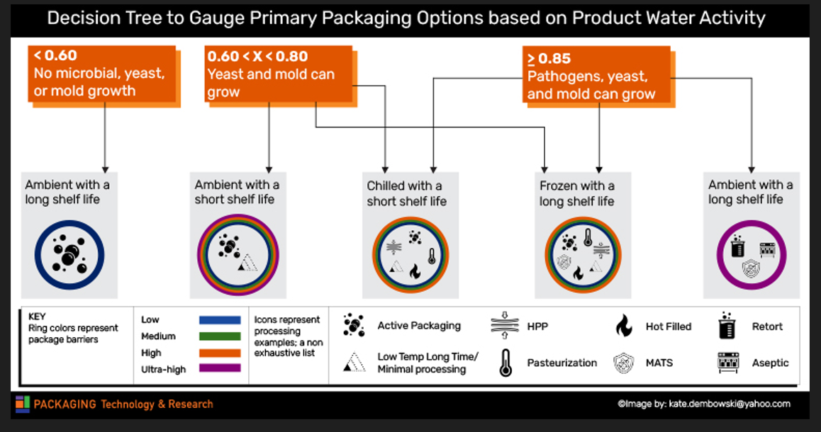
Making Decision l
Decision Trees: A Simplified Example

Slide 7
Decision Making I
Bayesian models show the future and implications and what is needed
Internalities & Externalities
Internalities
Goals
More sustainable food system
Planogram issues
Labor
OOS
Unmet consumer needs for size and product
Shifts in value chain drivers
Less food waste
Greater Resilience
Optimized costs
Space external to retail
Bayesian Model
  Externalities
    Natural disasters (drought, fires, flood, typhoon, hurricane, tornado)
    Human struggles (virus, famine, political upheaval)
    Power reliability (outages, internet, production)
    Variable sustainability pressures (bans, taxes, policies)

Slide 8
Decision Making I
Bayesian model history and theory
Bayesian belief network (BBN) - also Bayesian network, is a type of probabilistic reasoning graphical network based on Bayesian theorem
The method was first proposed by Judea Pearl in 1986
Bayesian formula application into the network problem can significantly simplify the problem, hence, can be applied to solve real-world complex problems
Early BBNs only used knowledge from experts in specific fields. Now, data diversification can turn continuous data streams into characterizing the problems node relationships
BBN supports fault diagnosis and reliability analysis

Slide 9
Decision Making I
Bayesian model history and theory
Bayesian networks are probabilistic graphical models representing system variables, and their conditional dependencies in a Directed Acrylic Graph and are composed of three elements:
A set of nodes representing management system variables
A set of links showing causal relationships between these nodes
A set of probabilities assigned to each node characterizing a belief that a node will be in a specific state as per the the state of the “parent” nodes
Then, conditional Probability Tables (CPT) are constructed.

Slide 10



Decision Making I
Bayesian models translate industry needs into parameters
Much of academic research is not applicable to industry needs
Bio-derived films that compete against bPE and bPET are an example
Using Bayesian models, parameters that need to be achieved, these films are better able to find a niche
Examples
Edible barrier for raw pet food company
Intelligent packaging for frozen vegetable supplier to QSRs
Active packaging example with bread
> Interactions
> XR Expands Tacit Knowledge
> Beta-Packaging Provides Agility
> AI to Achieve Planet-Centered Design

Slide 11
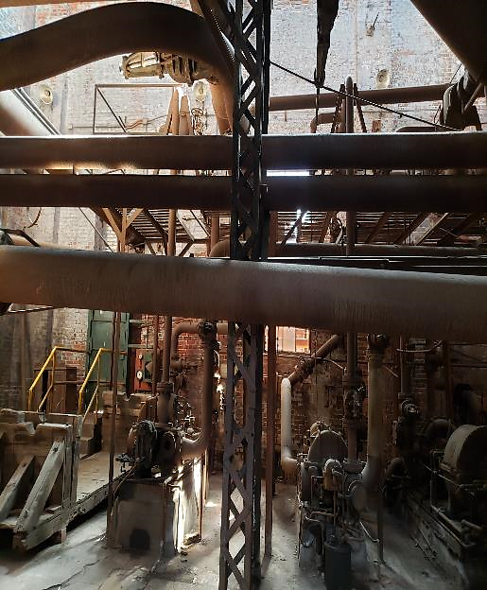
Method I
Use case scenario
This use case addresses what is considered when switching to a better barrier
Bakery considering converting to metalized film from OPP
Lower cost due to high oil prices and excess metalized capacity
Shelf life models show this will increase shelf life from 60 to 370 days

Slide 12
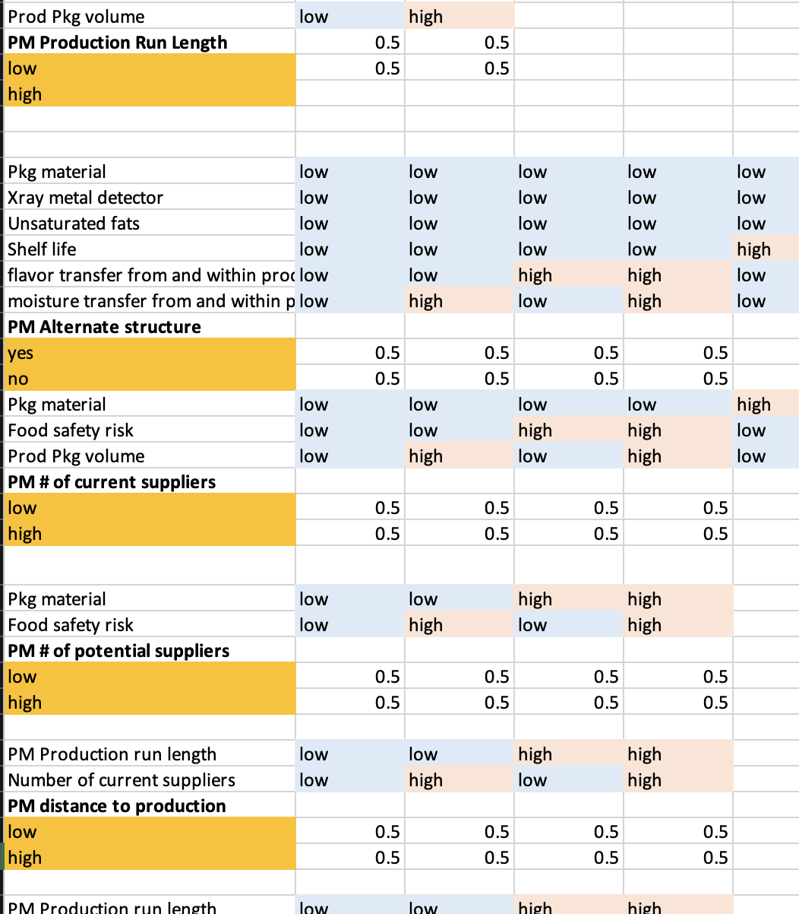
Method I
Defined Parent – Child relationships

Slide 13
Method I
Use case scenario – Defined Parent – Child relationships
Quality Assurance
Environment
Post Consumer Package Handling
Food Waste
Rick
Innovation
Food Safety
Marketing Distribution
Retailer
Packaging Converters
Ingredient supplier
Package properties
Production
Capital Investment

Slide 14
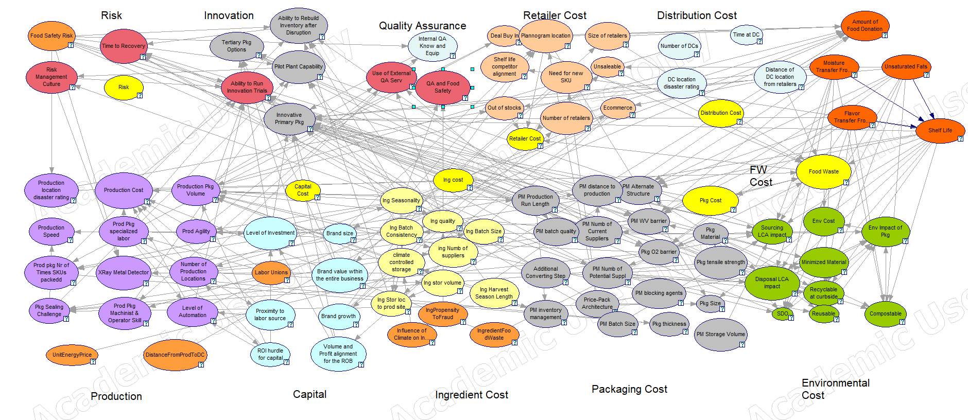
Results I
Implications

Slide 15
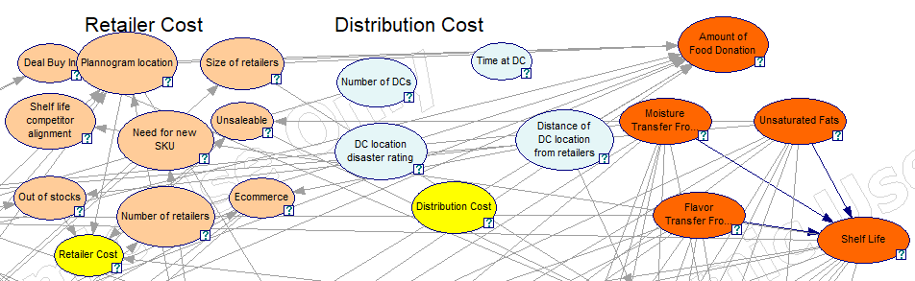
Results I
Implications

Slide 16
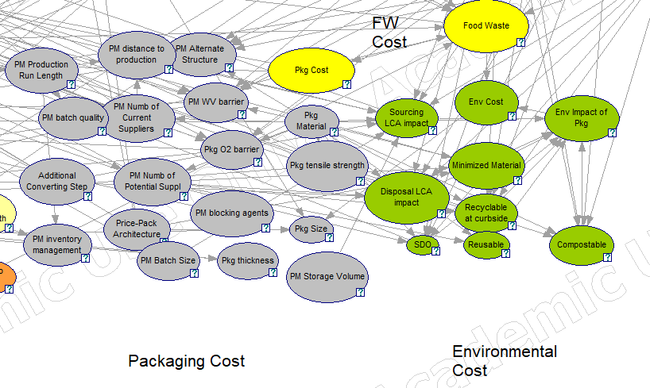
Results I
Implications

Slide 17
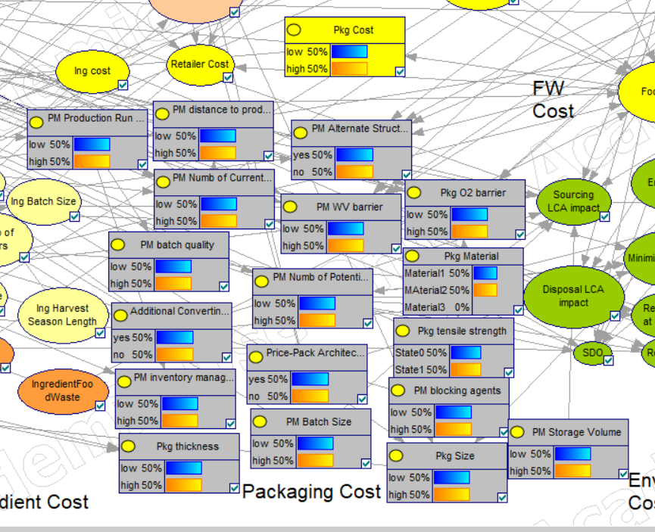
Results I
Bayesian modeling showed implications
> Beta-Packaging Provides Agility
> AI to Achieve Planet-Centered Design

Slide 18
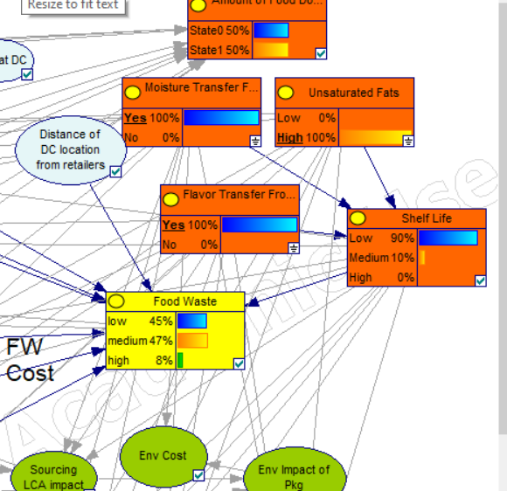
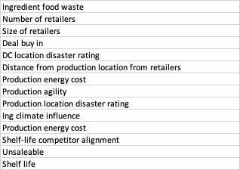
Results I
Implications
Parents
Low
High
Low
High
Low
High
Yes
No
Low
High
Near
Far
Low
High
Low
High
Low
High
Low
High
Low
High
Low
High
Low
High
Low
Food Waste
Med
High

Slide 19
KEY Take-Aways
Packaging has far-reaching implications beyond shelf life
Bayesian Models identify critical aspects and unintended consequences to enable implementation of this and other use cases
Use case results can be seen in Bayesian Models
Bayesian Models link industry and research

Slide 20




Thank you & Next Steps
Set up a virtual coffee
with Claire
or Ziynet
612.807.5341 claire@packagingtechnologyandresearch.com PackagingTechnologyAndResearch.com

