Slide 1
Industry Solutions to Phase out PFAs and other Chemicals of Concern in Packaging
Summer 2023

Slide 2
ABOUT PTR Claire Sand thinks “all food packaging all the time”
Claire’s mission is to enable a more sustainable food system with science and value chain innovations that more sustainably increases food shelf life and prevents food waste
35+ years of food packaging experience
Ranks innovative packaging science and value chain solutions to extend shelf life
Generates implementation roadmaps and aligns business cases
IFT Fellow, Riester-Davis-Brody life-time achievement in food packaging award recipient
Doctorate in Food Science and Nutrition at University of Minnesota
MS and BS in Packaging at Michigan State University
Owner
Adjunct
Professor
Monthly
Columnist
Current Leadership & Editorial Boards
Recent
Awards
CoChair
Consortium on
Food Waste
Advisor
Food Waste Repackaged
Executive Board
Riester-Davis-Brody
Food Packaging
Lifetime Achievement Award
Editorial Board
Associate Editor
Reviewer
National Science Foundation
Editorial Board
IFT Fellow
612.807.5341 / claire@packagingtechnologyandresearch.com / PackagingTechnologyAndResearch.com

Slide 3
Key Takeaways
PFAS regulations are creating stress
1
3
Industry has worked hard with a fragmented approach and pitfalls
PFAS sources in food are from production, processing and packaging
2
4
Future Proof Packaging is needed to avoid the pitfalls of a fragmented approach

Slide 4
Selected Sources of PFAS Primary Packaging
Primary Packaging | Secondary & Tertiary Packaging | Ingredients | Production Environment
1
2
3
4
Impart Improved Barrier
Release Agents | Forming Materials | Improving Barriers | Providing Grease & Oil Resistance
For Thermoforming, blowmolding | Wetting and leveling agents, emulsifiers, foaming agents, or dispersants | Fluorination of PE was approved in 1983 | Dry end coatings on paperboard and corrugated, and paper Lower the surface tension
 | Emulsifiers assist in producing Teflon examples include the use of PFOA | Now used during forming of in HPDE, PP, PET blowmolded, thermoformed containers | Wet end use on paperboard
 | Bond with functional groups such as acids and alcohols and/or take part in condensation polymerization of Nylon and PET | Primarily Polyﬂuoroalkyl substances | Coatings on hydroscopic polymers such as PLA, cellulose, starch, ethylenes, etc.
 |  | Polymers fluorinated with hexaﬂuoropropylene (HFP), tetraﬂuoroethylene (TFE), vinylidene ﬂuoride (VDF) polymers | Packaging for Pet food, bakery, FOH fried foods

Slide 5
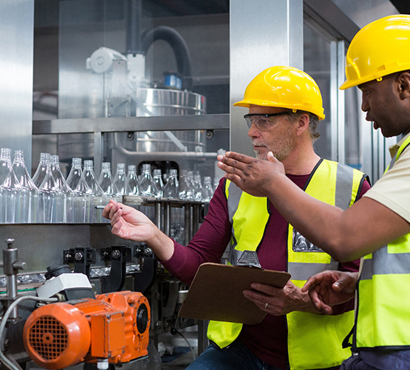
Industry Response has been Fragmented with Drop-in Solutions

Slide 6
Regrettable Substitutions are a Concern
These include:
CAS Reg. No. 9011-17-0
1-propene,1,1,2,3,3,3-hexafluoro-polymer with 1,1- difluoroethane modified with a halogenated ethylene
CAS Reg. No. 25190-89-0
tetrafluoroethylene-hexafluoropropylene vinylidene fluoride copolymers
CAS Reg. No. 9011-17-0
vinylidene fluoride-hexafluoro propene copolymer
CAS Reg. No. 94228-79-2
2,3,3,4,4,5,5-Heptafluoro-1-pentene polymer with ethene and tetrafluoroethene added in 2016
CAS Reg. No. 1279108-20-1
Hexane, 1,6-diisocyanato-, homopolymer, α-[1-[[[3-[[3 (dimethyl amino)propyl]amino]propyl]amino]carbonyl]-1,2,2,2-tetrafluoroethyl]-ω-(1,1,2,2,3,3,3-heptafluoropropoxy)poly[oxy[trifluoro(trifluoromethyl)-1,2-ethanediyl]]-blocked
CAS Reg. No. 464178-94-7
2-propen-1-ol, reaction products with 1,l,1,2,2,3,3,4,4,5,5,6,6-tridecafluoro-6-iodohexane, dehydroiodinated, reaction products with epichlorohydrin and triethylenetetramine as manufactured in accordance with the description in the FCN.
CAS Reg. No 464178-90-3
2-propen-1-ol, reaction products with pentafluoroiodoethane-tetrafluoroethylene telomer, dehydroiodinated, reaction products with epichlorohydrin and triethylenetetramine.
Perfluorohexane sulfonate (PFHxS)
CAS Reg. No. 69991-62-4
Perfluoropolyether dicarboxylic acid, ammonium salt.
CAS Reg. No. 200013-65-6
Diphosphoric acid, polymers with ethoxylated reduced methyl esters of reduced polymerized oxidized tetrafluoroethylene.
CAS Reg. No. 162492-15-1
Diphosphoric acid prepared by reaction of phosphorous pentoxide phosphate esters of ethoxylated perfluoro ether diol
CAS Reg. No. 1314-56-3
Diphosphoric acid prepared by reaction of phosphorous pentoxide
CAS Reg. No. 2466-09-3
Diphosphoric acid prepared by reaction of phosphorous pentoxide pyrophosphoric acid.
CAS Reg. No. 328389-91-9
Fluorinated polyurethane anionic resin prepared by reacting perfluoropolyether diol (CAS Reg. No. 88645-29-8), isophorone diisocyanate (CAS Reg. No. 4098-71-9), 2,2-dimethylolpropionic acid (CAS Reg. No. 4767-03-7), and triethylamine (CAS Reg. No. 121-44-8).
Other compounds that contain flouro-based compounds at wet and dry end paperboard production and in formation of plastics

Slide 7
Roadblocks hinder many Drop In Solutions
Release Agent Alternatives
Forming Polymers Alternatives
Improved Barrier Alternatives
Improved Barrier Alternatives

Slide 8
Roadblocks hinder many Drop In Solutions
Release Agent Alternatives
• Silicone resins and elastomers as release agents
• CAS 7473-98-5, 155419-56-0, 2855-27-8, 102782-94-5, 917773-10-5

Slide 9
Roadblocks hinder many Drop In Solutions
Forming Polymers Alternatives
Alternatives to polymers have a host of chemicals of concern beyond PFAs
Biodegradable alternatives are very problematic

Slide 10
Roadblocks hinder many Drop In Solutions
Improved Barrier Alternatives
Water barriers - alkyl succinic anhydride (ASA), styrene acrylic emulsion (SAE), alkyl ketene dimer (AKD) and rosin cannot be produced in sufficient volumes and are cost prohibitive now
Biopolymer PTF and synthetic polymer of PEN is promising

Slide 11
Roadblocks hinder many Drop In Solutions
Impart Grease / Oil Resistance Alternatives
Increased density with cellulose, carbon nanofibers, starch coatings during calendaring results in 20-30% slower production
Waxes or Polymer atomization, finishes, coatings may interfere with recycling
Removable and non-removeable plastic liners are not recyclable w/o SDO

Slide 12
Despite Industry efforts, PFAS is Still a Concern
Hiding behind regulations catches many off-guard
Shape-shifting supply chain
Regrettable substitutions exist
Industry experts know that substitutions may be regrettable
This is a costly, and time-consuming game of whack-a-mole
Data was hidden from FDA
GRAS status is dubious
Harmonious regulatory action is delayed
Reliance on voluntary abandonments
Snapshots do not protect brands or
consumers
Extensive incoming inspection is costly and is not in alignment with logistics
Hodge-podge of local and retailer bans

Slide 13
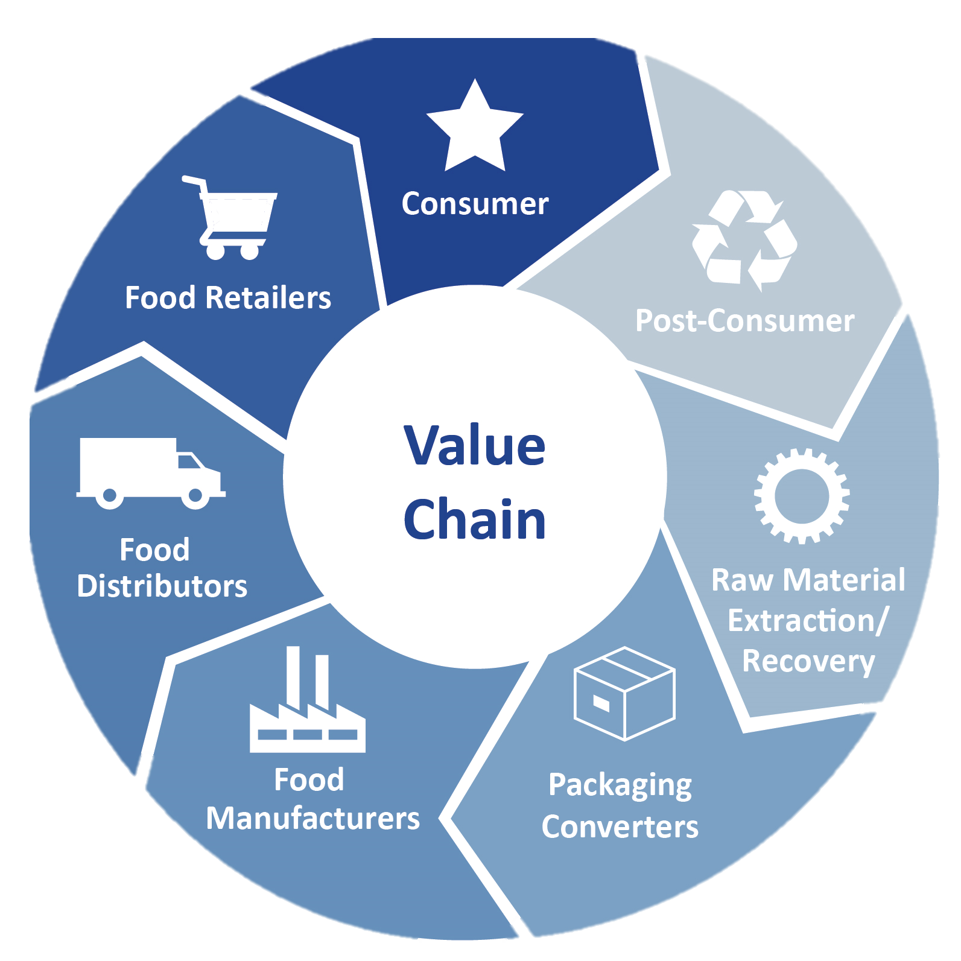
The Value Chain provides the opportunity to Future Proof Packaging
Future Proof
Packaging Value Chain

Slide 14
Value Chain provides the opportunity to… Future Proof Packaging
Proactively Plan for the Future - Avoid kicking the can down the road with regrettable substitutions
Build a more valued safety-focused relationship with regulatory agencies
Build/rebuild Trust in all entities of the packaging value chain
Align vs Entrap value chain partners
Collective work builds a better shared future
Future Proof
Packaging Value Chain
Future Proof
Packaging
Future-Proofed Packaging Value Chain

Slide 15
4 Key Value Chain Elements
to Future Proof Packaging
Inspire From The Top
Adjust to Reward Significance in Relationships
Share Work
Manage Knowledge

Slide 16
A Future Proof Packaging Approach
Elements
Adjust to Reward Significance in Relationships
Focus on the value in relationships
Internalize relevant externalities
Define meaningful incentive system for compliance between value chain entities
At all levels of organizations
Address economic pressures in value chain by balancing costs and profits

Slide 17
A Future Proof Packaging Approach
Elements
Inspire from the Top
Top-down focus
Shift from legal protection to inspiring action
Define role of PFAS and other Chemicals of Concern in UNSDGs, ESGs and CSV
Establish Value Chain linkages with all entities in the Value Chain
Redefine productivity

Slide 18
A Future Proof Packaging Approach
Elements
Share Work
Move beyond Taskforces to actual work
Build a Chain of Custody to instill confidence reduce fraud and add value
Deliver on shared innovations
Deliver on joint systems solutions
Work toward harmonized standards to avoid a 2-tier system in which some citizens are protected for chemicals of concern by regulations and some are not

Slide 19
A Future Proof Packaging Approach
Elements
Manage Knowledge
Manage Human knowledge
Involve inhouse and out-of-house seasoned experts
Manage Social Knowledge
Focus collectively on sources of PFAS
Define what regrettable substitutions should not be used
Manage Structured Knowledge
Define and share what is needed for joint systems solutions
Share knowledge transfer at all organizational levels

Slide 20
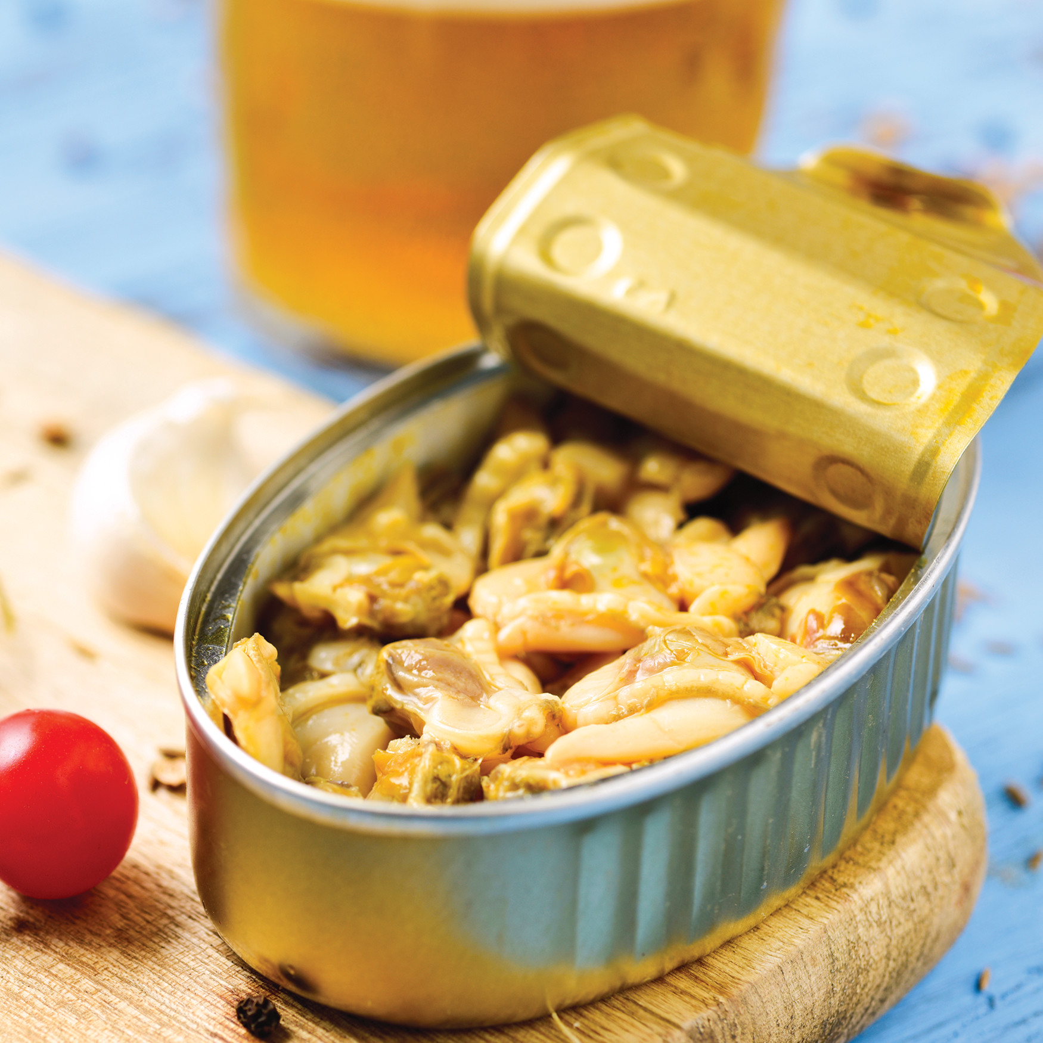
Case Studies

Slide 21
A Future Proof Packaging Approach Case Studies
System solutions to replace for oil and grease resistance need in FOH QSR french fry cartons
Non-PFAS plastic (reusable) packaging
Package redesign to
Employ a removeable plastic liner within FOH cartons
FOH cartons with a sealed low point with an adsorbent substance
FOH cartons dusted with an adsorbent substance
PFAS sensors on packaging for value chain use
Reduce oil in contact with packaging via a systems approach using one or all of these solutions
Reformulate fries to
Enhanced PME-based oil resistance so that less oil is adsorbed
BOH Processing to
Adsorb oil prior to FOH packaging with diatomaceous earth or food grade clays
Use a 2-phase system in which oil is drained more extensively at a station before final FOH packaging

Slide 22
A Future Proof Packaging Approach Case Studies
Reduce need for a high barrier in direct product contact via a systems approach using one or all of these solutions:
3. Reduce what needs to be controlled
Combine secondary and primary packaging investment for overall less packaging to monitor
4. Implement Intelligent packaging
PFAS sensors on packaging for value chain of custody
1. Advance Barrier technology from 1990s into 2020s
Provide barrier with enhanced polymer technology in the form of PTF, PEF, or PEN
Nanoclays to increase tortuosity
Barrier layers of EVOH, SiOx
Waxes – but this interferes with recycling
2. Flip the barrier
Food contact packaging with minimal barrier
Provide secondary packaging with enhanced barrier

Slide 23
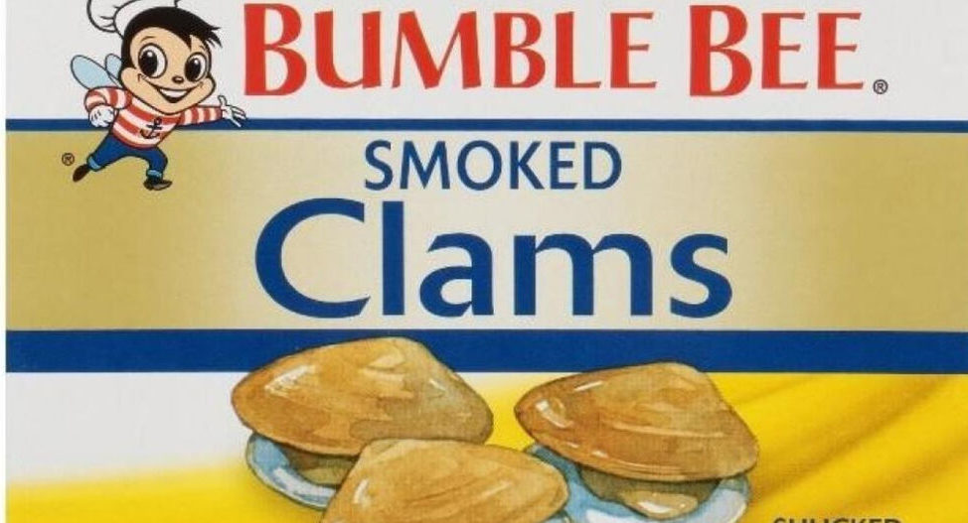
A Future-Proof Packaging Approach Case Studies
Reduce PFAS from contaminated water and feed in all seafood
Align with other stakeholders and take shared responsibility
This is instead of – “whew, the pressure of off packaging PFAS is everywhere!”
Work to define sources and then mitigate those sources
Engage seafood workers in re-engaging to earn a living in working on PFAS-free fishery development
Clean-up water
Engage to clean-up fisheries at issue so people can earn a sustainable living and sell safe seafood
Manage knowledge
Link solutions with packaging that communicates “products with no PFAS”
Define what is needed to provide assurances of “no PFAS”

Slide 24
Key Takeaways
PFAS regulations are creating stress
1
3
Industry has worked hard with a fragmented approach and pitfalls
PFAS sources in food are from production, processing and packaging
2
4
Future Proof Packaging is needed to avoid the pitfalls of a fragmented approach

Slide 25
Thank you
Dr. Claire Sand
Founder & Owner
Adjunct Professor, Michigan State University and CalPoly
Reach out to connect for
a virtual coffee

