Slide 1

Challenges Related to PFAS in Packaging
Thursday, May 11, 2023

Slide 2













Dr. Claire Sand thinks “all food packaging all the time”
Claire’s mission is to enable a more sustainable food system with science and value chain innovations that more sustainably increases food shelf life and prevents food waste
35+ years of food packaging experience
Ranks innovative packaging science and value chain solutions to extend shelf life
Generates implementation roadmaps and aligns business cases
IFT Fellow, Riester-Davis-Brody life-time achievement in food packaging award recipient
Doctorate in Food Science and Nutrition at University of Minnesota
MS and BS in Packaging at Michigan State University
Owner
Adjunct
Professor
Monthly
Columnist
Current Leadership & Boards
Recent
Awards
Executive Board
Riester-Davis-Brody
Food Packaging
Lifetime Achievement Award
Editorial Board
Associate Editor
Reviewer
National Science Foundation
IFT Fellow
Editorial Board

Slide 3
Key Takeaways
Strong bonds in PFAS extends its existence
1
3
Industry has worked hard with a fragmented approach and alternatives to PFAS
face roadblocks
PFAS sources in food are from production, processing and packaging
2
4
Future Proof Packaging is needed to avoid the pitfalls of a fragmented approach

Slide 4
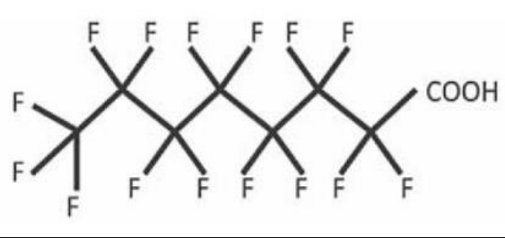
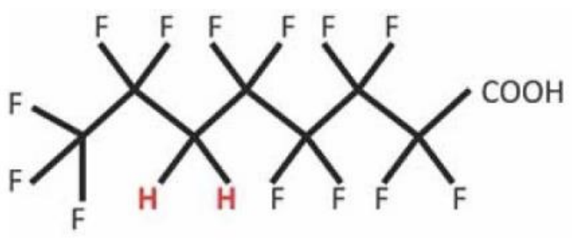
PFAS Overview
Perﬂuoroalkyl substances
• All Hydrogens attached to Carbons are replaced
by Fluorine
• Few degradation products and stable
Polyﬂuoroalkyl substances
  • Some Hydrogens attached to Carbons are
  replaced by Fluorine
• Can participate in condensation polymers
such as PET, nylon
• Many degradation products

Slide 5
The Long and the Short of PFAS
Long Chain PFAS (LCPFAS)
Banned in 2016
Perfluorocarboxylic acids (PFCAs) chain length >8
Includes perfluorooctanoic acid (PFOA)
Perfluoroalkane sulfonic acids (PFSAs) chain length >6
Includes perfluorohexane sulfonic acid (PFHxS) and perfluorooctane sulfonate (PFOS)
Short Chain PFAS (SCPFAS)
Approved and became regrettable substitutes
Perfluorocarboxylic acids (PFCAs) chain length <8
Perfluoroalkane sulfonic acids (PFSAs) chain length <6

Slide 6

LCPFAS were phased out in 2016
CAS Reg. No. 1071022-26-8
2-propenoic acid, 2-methyl-, polymer with 2-(diethylamino)ethyl 2-methyl-2-propenoate, 2-propenoic acid and 3,3,4,4,5,5,6,6,7,7,8,8,8-tridecafluorooctyl 2-methyl-2-propenoate, acetate
CAS Reg. No. 357624-15-8
Hexane, 1,6-diisocyanato-, homopolymer, 3,3,4,4,5,5,6,6,7,7,8,8,8-tridecafluoro-1-octanol-blocked
CAS Reg. No. 1071022-26-8
2-propenoic acid, 2-methyl-, polymer with 2-(diethylamino)ethyl 2-methyl-2-propenoate, 2-propenoic acid and 3,3,4,4,5,5,6,6,7,7,8,8,8-tridecafluorooctyl 2-methyl-2-propenoate, acetate
CAS Reg. No. 870465-08-0
Copolymers of 2-perfluoroalkylethyl acrylate, 2-N,N-diethylaminoethyl methacrylate, glycidyl methacrylate, acrylic acid, and methacrylic acid
CAS Reg. No. 479029-28-2
Copolymer of 2-perfluoroalkylethyl acrylate, 2-(dimethylamino)ethyl methacrylate, and oxidized 2-(dimethylamino)ethyl methacrylate (2)
CAS Reg. No. 220459-70-1
Glycine, N,N-bis[2-hydroxy-3-(2-propenyloxy)propyl]-, monosodium salt, reaction products with ammonium hydroxide and pentafluoroiodoethane-tetrafluoroethylene telomer ().
CAS Reg. No. 71608–61–2
Pentanoic acid, 4,4-bis [(gamma-omegaperfluoro-C8-20-alkyl)thio] derivatives, compounds with diethanolamine
Perfluoroalkyl substituted phosphate ester acids, ammonium salts formed by the reaction of 2,2-bis[([gamma], [omega]-perfluoro C4-20 alkylthio) methyl]-1,3-propanediol, polyphosphoric acid and ammonium hydroxide.
Copolymers of 2-perfluoroalkylethyl acrylate, 2-N,N-diethylaminoethyl methacrylate, and glycidyl methacrylate
3-cyclohexene-1-carboxylic acid, 6-[(di-2-propenylamino) carbonyl]-, sodium salt, reaction products with pentafluoroiodoethane-tetrafluoroethylene telomer, ammonium salts
Diethanolamine salts of mono- and bis (1H,1H,2H,2H perfluoroalkyl) phosphates where the alkyl group is even-numbered in the range C8–C18 and the salts have a fluorine content of 52.4 percent to 54.4 percent as determined on a solids basis

Slide 7
SCPFAS Were Phased Out In 2020
In 2020, The FDA began a 3-year phase out of 11 short-chain PFAS involved in 15 previous FCN approvals by manufacturers (Archroma, Asahi Glass, and Daikin Chemours. This includes:
CAS Reg. No. 1878204-24-0
  2-propenoic acid, 2-methyl-, 2-hydroxyethyl ester, polymer with 2-propenoic acid and 3,3,4,4,5,5,6,6,7,7,8,8,8-tridecafluorooctyl 2-methyl-2-propenoate, sodium salt
CAS Reg. 1440528-04-0
  Copolymer of 2-(dimethylamino) ethyl methacrylate with 3,3,4,4,5,5,6,6,7,7,8,8,8-tridecafluorooctyl methacrylate, N-oxide, acetate
CAS Reg. No. 1334473-84-5
  2-Propenoic acid, 2-methyl-, 2-(dimethylamino)ethyl ester, polymer with 1-ethenyl-2-pyrrolidinone and 3,3,4,4,5,5,6,6,7,7,8,8,8-tridecafluorooctyl 2-propenoate, acetate
CAS Reg. No. 1345817-52-8
  Butanedioic acid, 2-methylene-, polymer with 2-hydroxyethyl, 2-methyl-2-propenoate, 2-methyl-2-propenoic acid and 3,3,4,4,5,5,6,6,7,7,8,8,8-tridecafluorooctyl 2-methyl-2-propenoate, sodium salt
CAS Reg. No. 1206450-10-3
  2-propenoic acid, 2-methyl-, 2-hydroxyethyl ester polymer with 1-ethyenyl-2-pyrrolidinone, 2-propenoic acid and 3,3,4,4,5,5,6,6,7,7,8,8,8-tridecafluorooctyl 2-propenoate sodium salt
CAS Reg. No. 1071022-26-8
  2-propenoic acid, 2-methyl-, polymer with 2-(diethylamino)ethyl 2-methyl-2-propenoate, 2-propenoic acid and 3,3,4,4,5,5,6,6,7,7,8,8,8-tridecafluorooctyl 2-methyl-2-propenoate, acetate
CAS Reg. No. 357624-15-8
  Hexane, 1,6-diisocyanato-, homopolymer, 3,3,4,4,5,5,6,6,7,7,8,8,8-tridecafluoro-1-octanol-blocked
CAS Reg. No. 1158951-86-0
  2-propenoic acid, 2-methyl-, polymer with 2-hydroxyethyl 2-methyl-2-propenoate, α-(1-oxo-2-propen-1-yl)-ω-hydroxypoly(oxy-1,2-ethanediyl) and 3,3,4,4,5,5,6,6,7,7,8,8,8-tridecafluorooctyl 2-propenoate, sodium salt
CAS Reg. No. 1071022-26-8
  2-propenoic acid, 2-methyl-, polymer with 2-(diethylamino)ethyl 2-methyl-2-propenoate, 2-propenoic acid and 3,3,4,4,5,5,6,6,7,7,8,8,8-tridecafluorooctyl 2-methyl-2-propenoate, acetate ()
2-Propenoic acid, 3,3,4,4,5,5,6,6,7,7,8,8,8-tridecafluorooctyl ester, polymer with α-(1-oxo-2-propen-1-yl)-ω-hydroxypoly(oxy-1,2-ethanediyl
CAS Reg. No. 863408-20-2 , (CAS Reg. No. 1225273-44-8
  Copolymer of perfluorohexylethyl methacrylate, 2-N,N-diethylaminoethyl methacrylate, 2-hydroxyethyl methacrylate, and 2,2'-ethylenedioxydiethyl dimethacrylate, acetic acid salt () or malic acid salt).

Slide 8

PFAS Are Not
Alone In Packaging
Other Chemicals of
Concern Exist:
Phthalates
BPAs
Heavy metals
Perchlorate

Slide 9
Selected Sources of PFAS in Packaging
Primary Packaging | Secondary & Tertiary Packaging | Ingredients | Production Environment
1
2
3
4

Slide 10
Selected Sources of PFAS Primary Packaging
Primary Packaging | Secondary & Tertiary Packaging | Ingredients | Production Environment
1
2
3
4
Impart Improved Barrier
Release Agents | Forming Materials | Improving Barriers | Providing Grease & Oil Resistance
For Thermoforming, blowmolding | Wetting and leveling agents, emulsifiers, foaming agents, or dispersants | Flourination of PE was approved in 1983 | Dry end coatings on paperboard and corrugated, and paper Lower the surface tension
 | Emulsifiers assist in producing Teflon examples include the use of PFOA | Now used during forming of in HPDE, PP, PET blowmolded, thermoformed containers | Wet end use on paperboard
 | Bond with functional groups such as acids and alcohols and/or take part in condensation polymerization of Nylon and PET | Primarily Polyﬂuoroalkyl substances | Coatings on hydroscopic polymers such as PLA, cellulose, starch, ethylenes, etc.
 |  | Polymers fluorinated with hexaﬂuoropropylene (HFP), tetraﬂuoroethylene (TFE), vinylidene ﬂuoride (VDF) polymers | Packaging for Pet food, bakery, FOH fried foods

Slide 11

Selected Sources of PFAS Tertiary Packaging
Primary Packaging | Secondary & Tertiary Packaging | Ingredients | Production Environment
1
2
3
4
  Packaging containing PFAS can come in contact with and then contaminate other packaging that has direct contact with food
  Migration into food can occur through secondary packaging such as labels, coatings, and cartons into food
  Handling of secondary packaging and then food in second-stage BOH/Production environments can contaminate food

Slide 12

Selected Sources of PFAS Ingredients
Primary Packaging | Secondary & Tertiary Packaging | Ingredients | Production Environment
1
2
3
4
  Reusable packaging for bulk ingredient transport
    Includes totes, bags, liners, barrels, and bins
    Contamination of reusable totes occurs from prior use of PFAS contaminated ingredients
    Abrasion increases surface area and sites for subsequent migration
    Reuse increases migration due to contact time
  Single-use packaging for bulk ingredient transport
    Totes, bags, liners, barrels, and bins

Slide 13

Selected Sources of PFAS Production
Primary Packaging | Secondary & Tertiary Packaging | Ingredients | Production Environment
1
2
3
4
  Equipment used to form packaging
  • Cartoners, labelers, conveyors, thermoformers, unnesters, unscramblers inhibit sticking and make production line move smoother/faster.
  Production equipment used in food processing
  • Extruders, ingredient conveyance systems, hoppers, mixers
  • PTFE (Teflon-Polytetrafluoroethylene) is use for food processing equipment
  Water and CIP cleaning agents

Slide 14
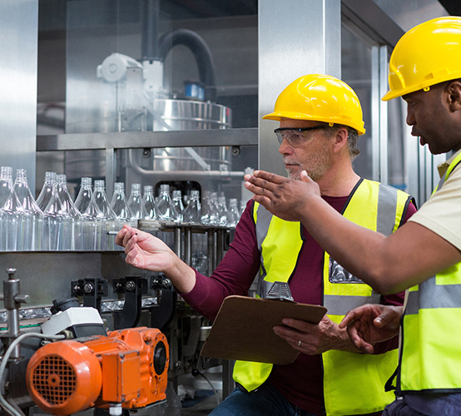
Industry
Response has been Fragmented with Drop-in Solutions

Slide 15



Roadblocks hinder many Drop In Solutions
Release Agent Alternatives
  Forming Polymers Alternatives
  Improved Barrier Alternatives
  Improved Barrier Alternatives
For many options, there are unintended consequences and/or regrettable alternatives in switching to the still approved SCPFAS

Slide 16
Regrettable Substitutions are a Concern
These include:
CAS Reg. No. 9011-17-0
1-propene,1,1,2,3,3,3-hexafluoro-polymer with 1,1- difluoroethene modified with a halogenated ethylene
CAS Reg. No. 25190-89-0
tetrafluoroethylene-hexafluoropropylenevinylidene fluoride copolymers
CAS Reg. No. 9011-17-0
vinylidene fluoride-hexafluoropropene copolymer
CAS Reg. No. 94228-79-2
2,3,3,4,4,5,5-Heptafluoro-1-pentene polymer with ethene and tetrafluoroethene added in 2016
CAS Reg. No. 1279108-20-1
Hexane, 1,6-diisocyanato-, homopolymer, α-[1-[[[3-[[3 (dimethylamino)propyl]amino]propyl]amino]carbonyl]-1,2,2,2-tetrafluoroethyl]-ω-(1,1,2,2,3,3,3-heptafluoropropoxy)poly[oxy[trifluoro(trifluoromethyl)-1,2-ethanediyl]]-blocked
CAS Reg. No. 464178-94-7
2-propen-1-ol, reaction products with 1,l,1,2,2,3,3,4,4,5,5,6,6-tridecafluoro-6-iodohexane, dehydroiodinated, reaction products with epichlorohydrin and triethylenetetramine as manufactured in accordance with the description in the FCN.
CAS Reg. No 464178-90-3
2-propen-1-ol, reaction products with pentafluoroiodoethane-tetrafluoroethylene telomer, dehydroiodinated, reaction products with epichlorohydrin and triethylenetetramine.
Perfluorohexane sulfonate (PFHxS)
CAS Reg. No. 69991-62-4
Perfluoropolyether dicarboxylic acid, ammonium salt.
CAS Reg. No. 200013-65-6
Diphosphoric acid, polymers with ethoxylated reduced methyl esters of reduced polymerized oxidized tetrafluoroethylene.
CAS Reg. No. 162492-15-1
Diphosphoric acid prepared by reaction of phosphorous pentoxide phosphate esters of ethoxylated perfluoroether diol
CAS Reg. No. 1314-56-3
Diphosphoric acid prepared by reaction of phosphorous pentoxide
CAS Reg. No. 2466-09-3
Diphosphoric acid prepared by reaction of phosphorous pentoxide pyrophosphoric acid.
CAS Reg. No. 328389-91-9
Fluorinated polyurethane anionic resin prepared by reacting perfluoropolyether diol (CAS Reg. No. 88645-29-8), isophorone diisocyanate (CAS Reg. No. 4098-71-9), 2,2-dimethylolpropionic acid (CAS Reg. No. 4767-03-7), and triethylamine (CAS Reg. No. 121-44-8).
Other compounds that contain flouro-based compounds at wet and dry end paperboard production and in formation of plastics

Slide 17
Roadblocks hinder many Drop In Solutions
Release Agent Alternatives
• Silicone resins and elastomers
as release agents
• CAS 7473-98-5, 155419-56-0, 2855-27-8,
102782-94-5, 917773-10-5

Slide 18
Roadblocks hinder many Drop In Solutions
Forming Materials Alternatives
Alternatives to polymers have a
host of chemicals of concern beyond PFAs
Biodegradable alternatives are very problematic

Slide 19
Roadblocks hinder many Drop In Solutions
  Improved Barrier Alternatives
Water barriers - alkyl succinic anhydride (ASA), styrene acrylic emulsion (SAE), alkyl ketene dimer (AKD) and rosin cannot be produced in sufficient volumes and are cost prohibitive now
Biopolymer PEF is promising

Slide 20
Roadblocks hinder many Drop In Solutions
Impart Grease & Oil Resistance Alternatives
Increased density with cellulose, carbon nanofibers, starch coatings during calendaring results in 20-30% slower production
Waxes or Polymer atomization, finishes, coatings may interfere with recycling
Removable and non-removeable plastic liners are not recyclable w/o SDO

Slide 21
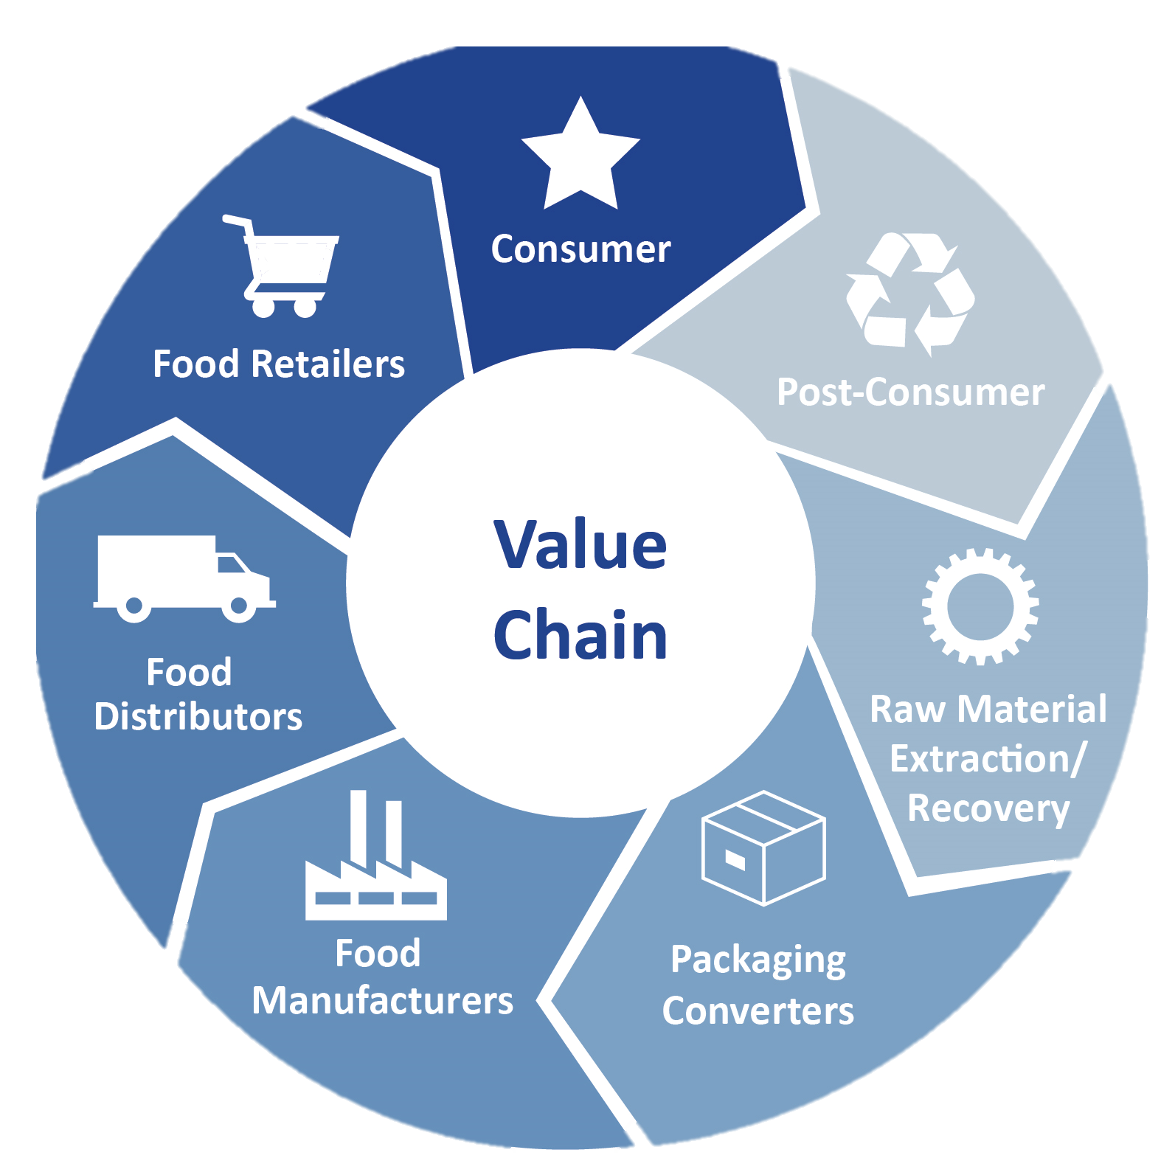
The Value Chain provides the opportunity to Future Proof Packaging
  Future Proof
  Packaging
  Value Chain

Slide 22
Value Chain provides the opportunity to address
Regulations that do not align with safety
Shape-shifting supply chain
Regrettable substitutions exist
  Industry experts know that
  substitutions may be regrettable
  This is a costly, and time-consuming
  game of whack-a-mole
  Hidden data
  GRAS status is dubious
  Delayed action continues
  Reliance on voluntary abandonments
  Snapshots do not protect brands or
  consumers
Extensive incoming inspection is costly and is not in alignment
Hodge-podge of local and retailer bans

Slide 23
Value Chain provides the opportunity to…
Future Proof Packaging
Proactively Plan for the Future - Avoid kicking the can down the road with regrettable substitutions
Build a more valued safety-focused relationship with regulatory agencies
Build/rebuild Trust in all entities of the packaging value chain
Align vs Entrap value chain partners
Collective work builds a better shared future
  Future Proof
  Packaging
  Value Chain
  Future Proof
  Packaging
  Value Chain
Future-Proofed Packaging Value Chain

Slide 24




A Future Proof Packaging Approach 4 Key Elements
  Inspire From
  The Top
  Adjust to Reward Significance in Relationships
  Share Work
  Manage Knowledge

Slide 25
A Future Proof Packaging Approach Elements
  Share Work
Collective work builds a better shared and safe future
Beyond Taskforces and to actual work
Build a Chain of Custody to instill confidence
reduce fraud and add value
Deliver on shared innovations
Deliver on joint systems solutions
Work toward harmonized standards to avoid a 2-tier system in which some citizens are protected for chemicals of concern by regulations and some are not

Slide 26

Case Studies

Slide 27

A Future Proof Packaging Approach Case Studies
    Non-PFAS plastic (reusable) packaging
    Package redesign to
    Employ a removeable plastic liner within FOH cartons
    FOH cartons with a sealed low point with an adsorbent substance
    FOH cartons dusted with an adsorbent substance
    PFAS sensors on packaging for value chain use
System solutions to replace for oil and grease resistance need in FOH QSR french fry cartons
    Reduce oil in contact with packaging via a systems approach using one or all of these solutions
    Reformulate fries to
        Enhanced PME-based oil resistance
        so that less oil is adsorbed
    BOH Processing to
    Adsorb oil prior to FOH packaging with diatomaceous earth or food grade clays
    Use a 2-phase system in which oil is drained more extensively at a station before final FOH packaging

Slide 28
Key Takeaways
Strong bonds in PFAS extends its existence
1
3
Industry has worked hard with a fragmented approach and alternatives to PFAS
face roadblocks
PFAS sources in food are from production, processing and packaging
2
4
Future Proof Packaging is needed to avoid the pitfalls of a fragmented approach

